Slide 1
Automatic Multiple
Tritium Sampler
Notes:
기술개발_자동식 삼중수소 다중 시료 채취기-1

Slide 2
CONTENTS
Ⅰ
Characteristics of CANDU Reactor & Tritium
Ⅱ
Tritium Measurements
Ⅲ
Needs of the equipment development
Ⅳ
Automatic Multiple Tritium Sampler(AMTS)
Ⅴ
Conclusions & Expectations
Ⅵ
Future Plans

Slide 3
Ⅰ
Characteristics of CANDU Reactor and Tritium
Characteristics of CANDU Reactor
▣ Natural Uranium Fuel contains 0.7% of U-235
▣ Use of the Heavy water (D₂O) as Coolant and Moderator
▣ The interactions of neutrons with Heavy water
→ Tritium Occurrence
▣ CANDU Reactor in Korea → Wolsong Plant 1 & 2

Slide 4
Ⅰ
Characteristics of CANDU Reactor and Tritium
Characteristics of Tritium
▣ Hydrogen with 2 neutrons exists gas or vapor status.
▣ Pure Beta-emitting radionuclide, Half-Life : 12.3 years .
▣ Maximum Energy : 18.6keV , Average Energy : 5.6keV
▣ Internal exposure is the more harmful to the body via
inhalation or wounds.

Slide 5
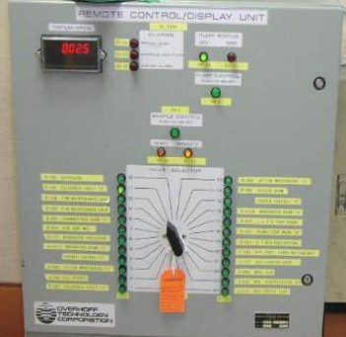
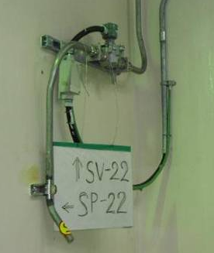
Ⅱ
Tritium Measurements
Methods of Tritium Measurement
▣ Use of the Fixed Tritium Air Monitors (FTAM)

Slide 6
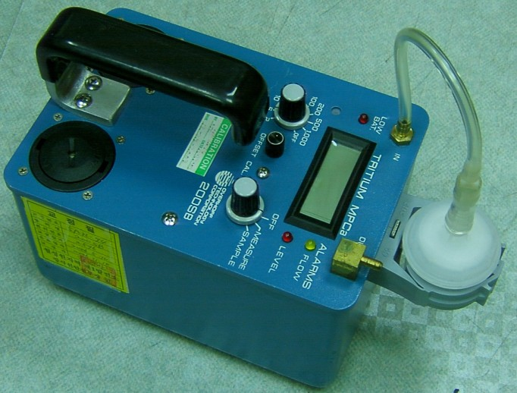
Ⅱ
Tritium Measurements
Methods of Tritium Measurement
▣ Use of the Portable Tritium Meter

Slide 7
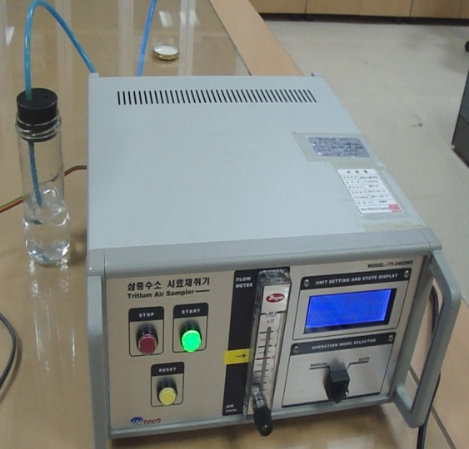
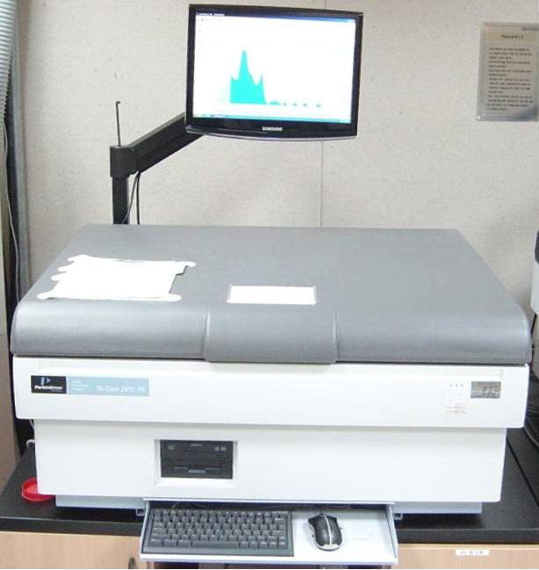
Ⅱ
Tritium Measurements
Methods of Tritium Measurement
▣ Use of the Liquid Scintillation Counter

Slide 8
Ⅱ
Tritium Measurements
Methods of Tritium Measurement
▣ Use of the Fixed Tritium Air Monitors (FTAM)
FTAM is fixed and installed at the
position of specific area.
Through 24 sampling ports lining with
metal pipes, select one port
to sampling by suction pump.
Using the ion chamber detector
to measure, Good reliance of
Measurement .

Slide 9
Ⅱ
Tritium Measurements
Methods of Tritium Measurement
▣ Use of the Portable Tritium Meter
Easy to carry-on and comfortable
to use.
Simultaneously, suction and
measurement of the sampling gas.
Use of the ion chamber detector to
measure, but reliance of measurement
is normal.

Slide 10
Ⅱ
Tritium Measurements
Methods of Tritium Measurement
▣ Use of the Liquid Scintillation Counter
With the similar chemical properties,
Tritium can dissolve into the water .
Air suction with the tritium → Bubbler
→ Sample bottle [100cc] →
Sample Volume for measurement [10L]

Slide 11
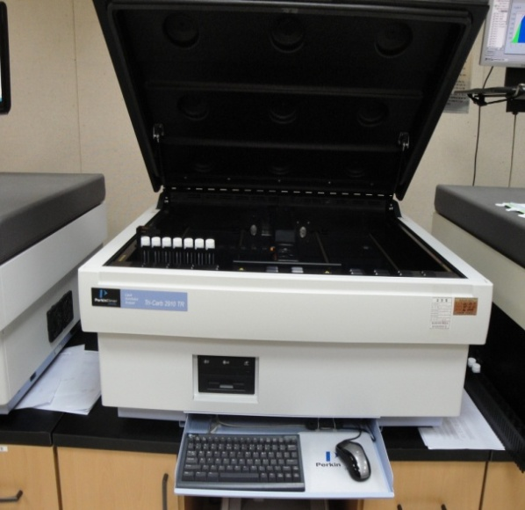
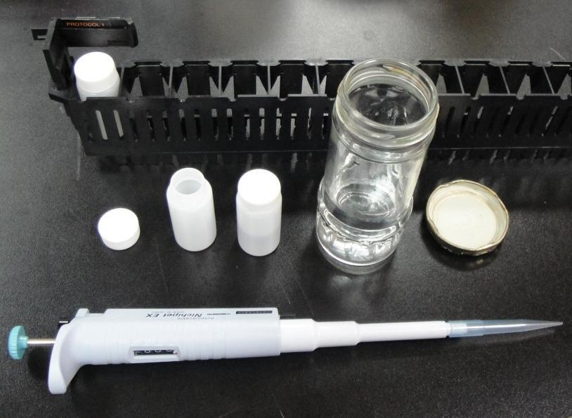
Ⅱ
Tritium Measurements
Methods of Tritium Measurement
▣ Use of the Liquid Scintillation Counter
Collected tritium samples(1cc) and
fluorescent solution (10cc) prepare
by mixing
Measure the sample with
the scintillation counter
Using the scintillation detector to
measure, good reliance of
measurement.

Slide 12
Ⅱ
Tritium Measurements
Status of Tritium measurements
▣ Observations of radiation for several areas in Radiation zone
with the routine ^{[*1)} tritium sampling and analysis
Sampling | NPP#1 |  | NPP#2 |  | TRF ^{[*2)}
 | Positions | Times | Positions | Times | Positions | Times
Days | 10 | 30 | 9 | 27 | 6 | 18
Weekly | 3 | 9 | 3 | 9 | 2 | 6
[*1) 3 shift operators on duty
[*2) TRF(Tritium Removal Facility)

Slide 13
Ⅱ
Tritium Measurements
Status of Tritium measurements
▣ At the abnormal situation(Tritium concentration rising),
add the sampling points around the suspicious leakage
area.
▣ At the leakage situation of Tritium, add the additional
sampling and measurements of Tritium concentration.
▣ One sample with a Bubbler.

Slide 14
Ⅲ
Needs of the equipment development
▣ A variety of sampling point & how to sampling by each
operator
Operator
▣ Bubbler can sample only one point with a bubbler
▣ Sampling during abnormal concentration rising are
difficult.
Methods
▣ Lack of sampling equipment holdings for emergency
▣ No record sampling times, No time reservations features
▣ The unexpected change of flow meter can cause the
sampling volume.
Equipment

Slide 15
Ⅲ
Needs of the equipment development
Methods
▣ Bubbler can sample only one point with a bubbler.
▶ Sampling of multiple points need with a bubbler.
▣ During the abnormal situation , Operator increase
to sample because of the sampling interval time
is shorter.
▶ During sampling at the same point, it needs
a equipment that able to automatic sample with
the setting time.

Slide 16
Ⅲ
Needs of the equipment development
Equipment
▣ Busy Outage and equipment contamination can
cause a lack of equipment .
▶ Equipment needs multiple sampler line and
requires a self-cleaning function.
▣ Equipment itself does not record the sampling time.
▶ Need the sampling time storage function .

Slide 17
Ⅲ
Needs of the equipment development
Equipment
▣ The unexpected setting change of flow meter(LPM)
can cause the sampling volume change.
▶ Need the automatic correction features in
accordance with the change of flow rate(LPM).
▣ No Sampling reservation function.
▶ Need Sampling reservation function.

Slide 18
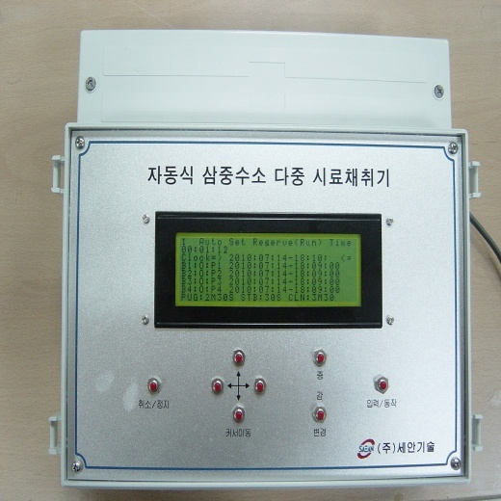
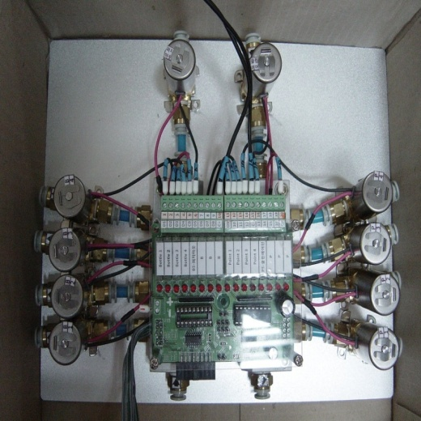
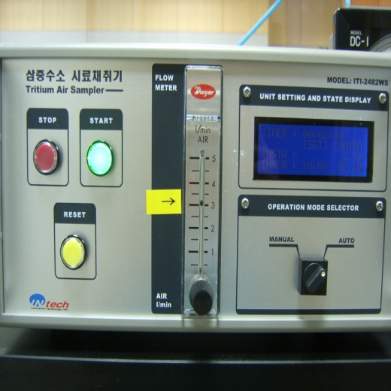
Ⅳ
Automatic Multiple Tritium Sampler(AMTS)
Prototype of the Sampler
Main controller
Sample selector
Bubbler

Slide 19
Ⅳ
Automatic Multiple Tritium Sampler(AMTS)
Configuration of the Sampler
Purge out
Clean air
Solenoid valve
Sample selector
Operation Display LED
Control signals
Bubbler
Main controller

Slide 20
Ⅳ
Automatic Multiple Tritium Sampler(AMTS)
Work flow of the Sampler
Purge out
Clean air
Solenoid valve
Sample selector
Sample point 4
Operation Display LED
Sample point 3
Control signals
Sample point 2
Sample point 1
Bubbler
Main controller

Slide 21
Ⅳ
Automatic Multiple Tritium Sampler(AMTS)
Specifications
Main Controller
8 Bit Microprocessor with Watchdog Timer
32 kbyte EEPROM, 8 kbyte SRAM
12 Bit A/D 4 Channel, 12 Bit D/A 2 Channel
8 key Input (cursor movement, decrease, return, action)
240 x 64 Pixel Graphic LCD with LED Back Light
Real Time Clock Chip (Back Up Battery life 10 years)
10 Port Samples Selector Control (Power transistor driven by the relay)
Bubbler Control of Photo Coupler
(work orders, stop orders, work situation )

Slide 22
Ⅳ
Automatic Multiple Tritium Sampler(AMTS)
Specifications
Sampling Air Selector
4 Input Port + 1 Clean Air Port, 4 Out Port + 1 Purge Air Port
Path selection by solenoid valves (DC + 24V powered)
Power transistors, driven by a relay (10 Port)
Bubbler
Photo Coupler automatically controlled by the Bubbler
Subject made by the purge, stabilization, bubbling, automatically
perform a clean operation
10 Liter Air Sampling (3 Liter Per Minute Sampling Speed)

Slide 23
Ⅳ
Automatic Multiple Tritium Sampler(AMTS)
Application Tests at Local Point
AMTS Test 1 – Continuous Measurements
▣ The time required for 4 points sampling with one Bubbler
(Sampling time = 10minutes / sampling x 4sampling = 40minutes)
◈ The necessary time applied with AMTS
(Sampling time = 6minutes / sampling x 4sampling = 24minutes)
▶ 16 minutes shorter

Slide 24
Ⅳ
Automatic Multiple Tritium Sampler(AMTS)
Application Tests at Local Point
AMTS Test 1 – Continuous Measurements
▣ The time required for 4 points sampling with two Bubbler
(Sampling time = 10minutes / 2bubbler x 4sampling = 20minutes)
◈ The necessary time applied with AMTS
(Sampling time = 6minutes / 1bubbler x 4sampling = 24minutes)
▶ Two bubbler effects

Slide 25
Ⅳ
Automatic Multiple Tritium Sampler(AMTS)
Application Tests at Local Point
AMTS Test 2 – Time settings
▣ To reduce Sampling Error – Sampling time
(Time on/off by operator – human error)
◈ AMTS sampling program
- Sampling start at scheduled time ( 30 minutes, 1 hour …)
→ Automatically purge and self-cleaning
▶ Realization and reliability of unmanned automated collection

Slide 26
Ⅳ
Automatic Multiple Tritium Sampler(AMTS)
Unmanned automation and standardization of Sampling depending on reliability improvement
Standardization
Of Sampling Procedures
Save the Sampling time
Unmanned automation
After the initial setup,
all sampling can obtain
automatically without
people.
Also, operators can do any
other tasks and services.
With the developed equipment,
it shows
two equipment effects
with one bubbler.
Anyone who has a
certain time can sample
in the same way.
Unmanned
automation
Save the
Sampling
time
Standardization
Of Sampling
Procedures

Slide 27
Ⅴ
Conclusions & Expectations
When tritium sampling at the several area in Radiation Control zone,
it expects the shorter time to sample with the AMTS.
More then 2 sampling positions can concentrate a sampling position.
The more effects the tritium concentration surveillance .
With the reservation function of AMTS, it is possible to sample and to purge periodically according to the setting time and the setting procedure.

Slide 28
Ⅴ
Conclusions & Expectations
When heavy water leakage breaks out, it can sample on the various areas within the shorter time, takes any actions quickly for emergency situation.
After the outage, it is possible to observe quickly around the suspected heavy water leak area during the reactor start operation.
After the outage of Wolsong Unit #1, it is possible to observe quickly around the suspected heavy water leak point.

Slide 29
Ⅵ
Future Plans
Improvements
Simultaneous
function
Portable
function
Storage
function
AMTS has a sampling pump ,
sampling can not be done more than 2 points simultaneously.
Consists of the three separated elements,
it is difficult to carry on and movement.
At the abnormal loss of power,
it can be lost all of sampling data.

Slide 30
Ⅵ
Future Plans
Simultaneous function
Improve the equipment to sample more than 2 points at the same time.
Portable function
Improve the equipment All- in-one and portable.

Slide 31
Ⅵ
Future Plans
Storage function
Improve the program to store the sampling status automatically.
TAM function
Apply TAM function to portable tritium measurement.
⇒ Unmanned automatic tritium measurement.

Slide 32
Thank you

