Slide 1
Evolution of radioactive waste management
Yonggwang NPP Unit 5&6
Notes:
Good morning, My Name is lee gui jong. I’m from youngkwang NPP unit 5&6.
I’m pleased to have an apportunity to be acquainted with you.
Our Plant reduced a lot of radioactive waste in Recent Outage
Now , I’ll show you our practice
Topic is Real time radiowaste management program

Slide 2
Contents
Background
Status & Problem
Plan & Improvement
Effects
Future plan
Notes:
Contents are as follows
First, I’ll explain you the background of our practice and efforts
And Next , …
Finally, I’ll finish this presentation by saying the future plan.

Slide 3
Background
In case of radiation exposure management
Disposal Cost : about $8,000 / drum
5,000 drum /yr, company (2009)
Enhanced management of Radioactive wastes
Investigation factor and patterns from workplace generation
of radwaste to drumming
Need for analysis system
Before
improve
Every step intervention
collection wastes
and drumming
Waste classification (work place)
Segregation and Collection
(contaminated/clean)
Notes:
Recent year, Radwaste reduction is a pending item for our company .
radioactive waste disposal cost is increasing highly . It’s up to about 8,000 per drum
And Site Storage warehouse is almost Full
to solve this problem, We have to upgrade Radioactive wastes management
Before We made drum after collecting radwaste . But, from now on we must have every step intervention from work place to druming
we have to classify waste and segregate and collect and we have to feedback
To carry out this works effectively , we need price analysis system

Slide 4
Background
Radioactive Waste Management has been 2’nd priority
Radiation exposure management in NPPs
ALARA committee & peer group
Advanced Equipments and techniques
(CCTV, Real-time systems, zinc injection, Ultra sonic cleaning, etc)
Extensive Data Bases and servers for exposure reduction
Collective dose at Yonggwang : 0.29man-Sv/ unit (2009)
- world average in light water nuclear reactors : 0.85man-Sv/unit-yr
Just to begin to enhance the radioactive waste management
no systematic data base

Slide 5
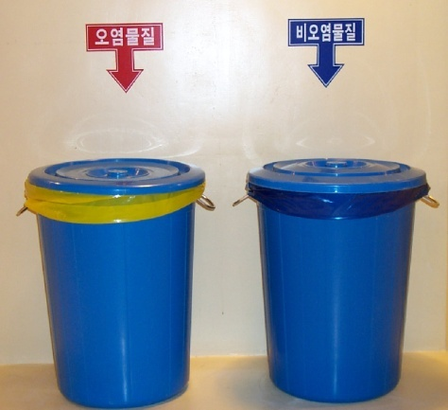
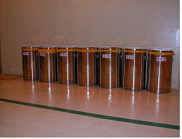
Status & Problem
After works, Wastes was mixed and discarded regardless of contamination
Waste without cross contamination
Increased radwastes volume
Unregistered wastes
No guard to monitor and classify
- radwastes increase , without Feedback
Before : Workers freely discarded waste into bin installed registered area
~ 2007
2008 ~
< Contaminated / clean >
<Radwastes type : paper, vinyl, iron etc>
Notes:
Now , I’ll brief on present status and problem
Until now, -----
And waste was not registered
To see Below pictures . Before, we used waste collection bin
So, works ------

Slide 6
Status & Problem
All Drums even though partial contaminated
Pay no efforts and interests in reduction
- Recycle possibility, partial decontamination or removal
Without Characterization and volume reduction
Poor system on Classification and characterization
Without Adequate action to reduce
(wash, decontamination, delay & decay, others)
Poor management of Liquid radwastes
Uncontaminated Clean water(2ry) in RCA usually entered in Liquid radwaste disposal System (Closed Cooling Water, Chilled Water)
- LRS ion Exchange resin was saturated with high chemical concentration and treated with radwaste
Temporary drain water(Boric Acid water) mixed with foreign materials
accelerated resin saturation
Finally, generating radwastes by replacing Charcoal, Resin, MF/RO in LRDPS
Notes:
And , another problem was all drumming ----
We did not pay --- ---- --- we ignored ----
And there was no --- and adequate Volume reduction.
IF We should have adequate treatments like as wash, decon., delay&decay
We woud reduce waste still more but we did not until now
Another problem is poor ---
--------
with the reason, LRS ------ MOREOVER ---- finally radwaste generated ---

Slide 7
Plan for Improvement
Wastes collection station (PAB 77’)
Take wastes collection bag
Register Name in charge of wastes
Reducing action before work
Real time Measuring & Recording (PAB 77’)
Estimate the quantity of waste
Review the activity of workers
Measuring, Classifying,
Collecting & Recording
⇒ by waste types
⇒ by related works
⇒ contaminated or
clean
⇒ daily & cumulative
Real time
Management
Restrict carrying unnecessary materials in RCA at entrance
monitoring shift for wastes
regular check for work place
classify & help to treat wastes
(contaminted / clean)
Notes:
To improve this previously mentioned problems
we decided to real time manage and feedback for radwaste reduction
First , ----
And . Install and use operate --- in that place, use the ----
And , monitoring
To carry out All this plan, we developed the real time radwaste management

Slide 8
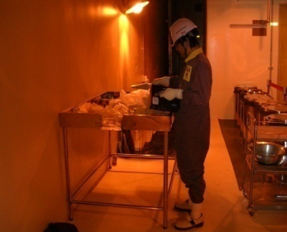
Improvement
Development & operation
of Real-time management program for Radwastes
Field Data
Program
collection Station
Data Base
Daily General Status Report
Location : PAB 77’
Real time classifying
& Summarizing
daily general status
Radwaste types D/B
Works / radwaste types / contaminated or clean
Related works D/B
cumulative Trend
Main Works / Radwaste types
contaminated/clean D/B
Daily / cumulative
analysis
daily / cumulative D/B
investigating & recording ⇒ Main generation source
⇒ excessive / unnecessary
Radwastes reduction
Feedback (analysis & action)
Notes:
this slide shows overview of realtime radwaste program
In the waste collection station we classify, segregate, collect radwaste and summarize and transfer these field data to program
Field data is accumulated by various database
----
And produce daily general status report
It contains general status and Daily /cumulative trends and analysis and feedback
About waste, related works, types , generation sources, whether it is excessive or not
With this realtime management we are able to analyze precisely feedback adequately and promptly
As a result radwaste was reduced actually.

Slide 9
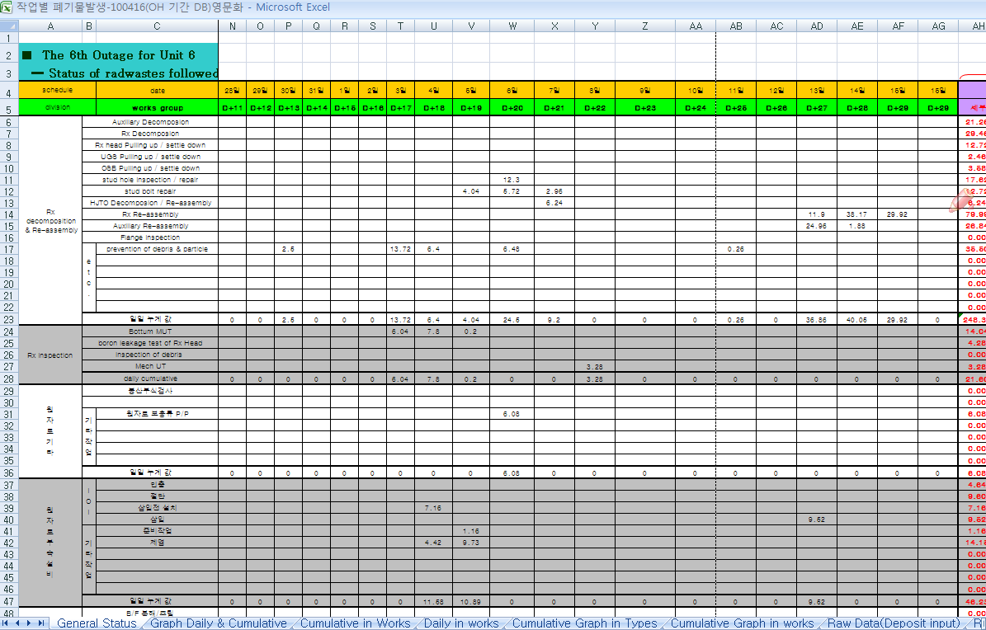
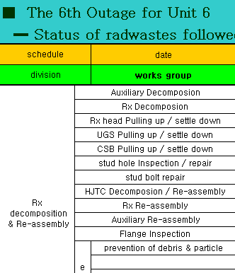
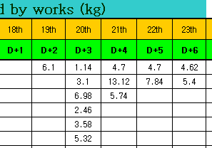



Improvement
Real-time management program (DATA BASE)
Notes:
This slide is captured databasecscreen
All works are sorted by related groups and reported by daily
There are various D/B . general ststus D/B, -----

Slide 10
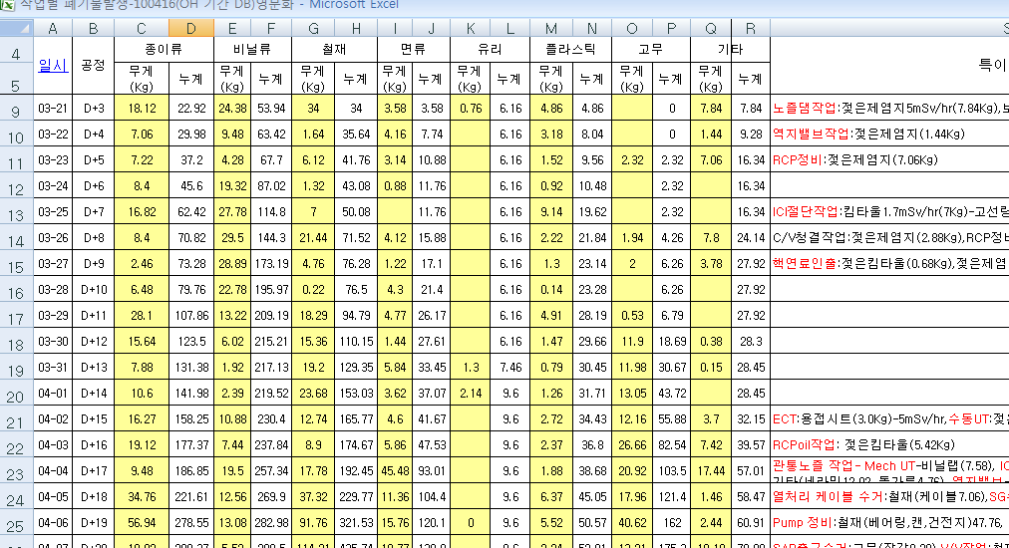
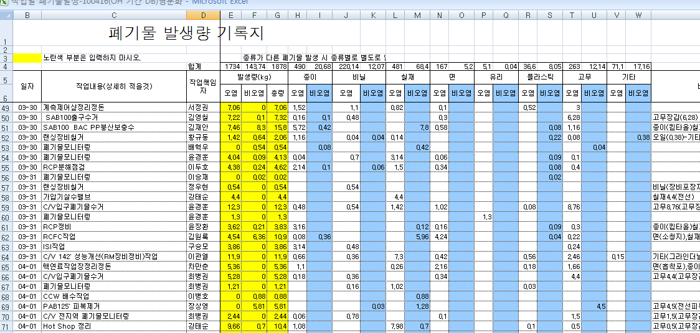
Improvement
Real-time management program (DATA BASE)
Waste collection station RAW DATA
Waste collection station RAW DATA (Person & Works)
Person
Types
Con/clean
Related Works
Amount
Notes:
and Also, we used input D/B at the waste collection station
in that place we enter waste data like as amount, types, works person, contam or uncontam

Slide 11
Improvement
Real-time management program (Daily general report – 1page )
Daily work status
D+24
No. | Work | Radwastes |  | Note
 |  | Type | weight(kg)
1 | V/V Warehouse Arrangement(PAB 77’) | Paper, Vinyl, Iron, Rubber, Plastic | 50.48 | Paper(0.56), Vinyl(0.58), Iron(47.3), Rubber(1.68), Plastic(0.36)
2 | In-Service Inspection (ISI) | Paper, Vinyl, Iron, Rubber, Plastic, Cloth, etc. | 10.66 | Paper(2.98), Vinyl(0.94), Iron(0.46), Rubber(0.52), Plastic(1.56), Cloth(2.74), Wood(1.46)
3 | Plugging tool’ s Removal & Decontamination | Paper, Vinyl, Rubber, | 9.64 | Paper(5.68), Vinyl(1.8), Rubber(2.16)
4 | SG Drain Nozzle Equip. Decontamination | Paper, Iron, Rubber, Plastic, Cloth | 9.5 | Paper(7.06), Iron(1.42), Cloth(0.14), Rubber(0.84), Plastic(0.04),
5 | Grapple processing | Paper, Vinyl, Rubber, Cloth | 5.8 | Paper(0.8), Vinyl(2.94), Rubber(0.98), Cloth(1.08)
6 | RCB wastes Monitoring | Paper, Vinyl, Iron, Rubber, Plastic, Cloth, | 3.66 | Paper(3.0), Vinyl(0.08), Iron(0.06), Rubber(0.1), Plastic(0.28), Cloth(0.24)
7 | essential chiller decomposition | Iron | 3.46 | Iron(3.46)
Notes:
and now, I will show you daily general report
1page, there is daily -----
All works of the day are displayed with waste data like as types, weight, person contam/un contam

Slide 12
Improvement
Real-time management program (Daily general report – 2page )
Daily Trend
D+30
Notes:
2page daily trend is diplayed
important event of the day are marked for current analysis

Slide 13
Improvement
Real-time management program (Daily general report – 3page )
Cumulative by works
D+24
Work |  | Daily | Cumulative | Work | Daily | Cumulative
Rx | Decomposition & assembly | 0.00 | 141.30 | Primary Pump | 3.46 | 128.06
 | Inspection | 0.00 | 21.60 | Primary V/V | 0.00 | 203.77
 | etc | 0.00 | 6.08 | ISI | 10.66 | 38.50
 | Auxiliary Equip. | 0.00 | 36.71 | Radiation Safety Control | 0.00 | 73.80
Refueling |  | 5.80 | 20.62 | Decontamination & Wash | 0.00 | 56.64
S / G | Man-Way | 0.00 | 7.02 | Radwastes Treatment | 3.66 | 14.34
 | Nozzle dam instal & removal | 0.00 | 39.10 | Instrument Equip. Work | 0.00 | 16.60
 | U-Tube ECT | 0.00 | 41.16 | Etc. Works | 50.48 | 262.69
 | Lancing/FOSAR | 0.00 | 25.73 | SAB Waste monitoring | 0.00 | 64.14
 | U-Tube Plugging | 9.64 | 9.64 | RCB exit | 0.00 | 101.65
 | Drain Nozzle Repair | 9.50 | 55.70 | Waste Monitoring | 0.00 | 34.19
RCP Decomposition & inspection |  | 0.00 | 100.61 | Improvement of Refueling Machine | 0.00 | 61.25
 |  |  |  | SUM | 93.20 | 1,560.90
Notes:
3 page
We devided all works by 24 groups And summarized daily and cumulative

Slide 14
Improvement
Real-time management program (Daily general report – 3page )
D+30
Notes:
And displayed aby graphic style for more convinence

Slide 15
Improvement
Real-time management program (Daily general report – 2,4page )
Weight
(kg)
Division | Paper | Vinyl | Iron | Cloth | Glass | Plastic | Rubber | etc | SUM
Daily | 2.76 | 1.18 | 1.18 | 0.38 | 0.00 | 0.00 | 3.84 | 0.00 | 9.34
Cumul Ative | 541.5 | 350.8 | 547 | 179.2 | 11.3 | 57.7 | 255.2 | 97.8 | 2,040
Paper Vinyl Iron Cloth Glass Plastic Rubber etc.
Notes:
2, 4 page
cumulative by waste types is displayed
throughout this chart, we are able to know that during outage main waste types are paper, vinyl, iron
So, we are under conderation to reduce such types

Slide 16
Improvement
Real-time management program (Daily general report – 4page )
Daily Analysis & Feedback
D+24
No. | Analysis & Feedback | Remark
1 | Iron From PAB 77’ "A“ KPS Valve Team Warehouse Cleaning - Atfer Contamination Inspection, Moving Contaminated Iron to RWB Decay & Storage Area - Amount : Iron 47.3 kg | After Decontamination, Keeping in RWB Decay & Storage Area - long term Decay
2 | Request related Worker to reduce Decontaminating Paper - SG Drain Nozzle & Plugging Equip. Decontamination works - Amount : Wet Paper 47.3 kg | Drying Wet Paper and Druming Separating Reusable Paper
3 | Forecasting for Warehouse Cleaning & arranging - KPS Warehouses, RCB Temporary Warehouse | Waste Monitoring
4 | etc. - Wood : ISI (1.56 kg) | -
Notes:
4 page
We analyzed daily result and carry out feeback likes as this note
I will introduce d+24day analysis and feedback
that day iron was generated 47 kg . So, we transfer to decay and storage area
for decontamination , delay & decay

Slide 17
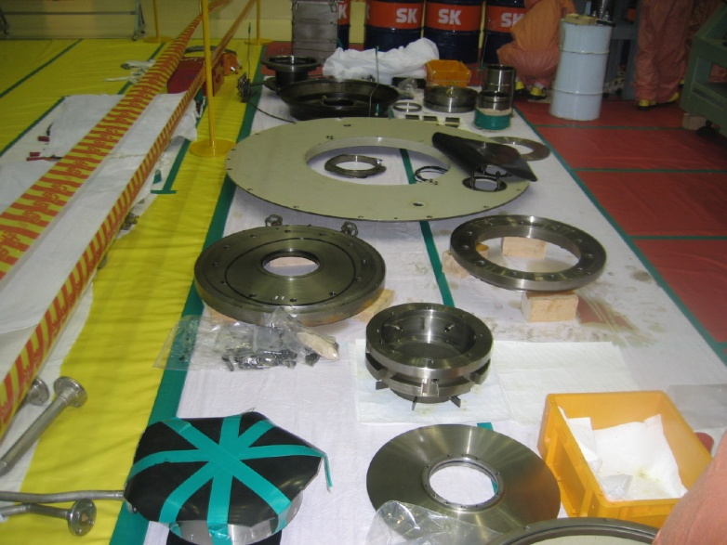
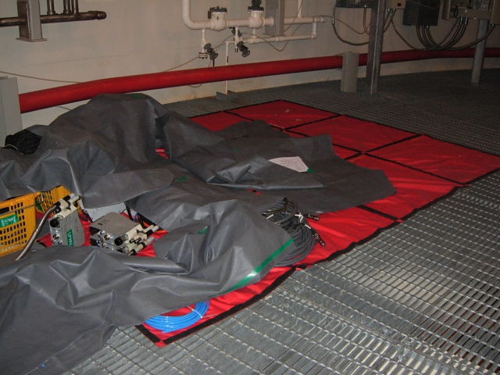
Main Examples - Real time management
CASE | Real time management | Remark
Separating as Clean waste | Separating in Working Area and waste collection station | 166.35 kg as clean
Vinyl | Replace Vinyl with Washable Matts (fabric material) | -
Before(vinyl)
Improve (washable fabric matt)

Slide 18
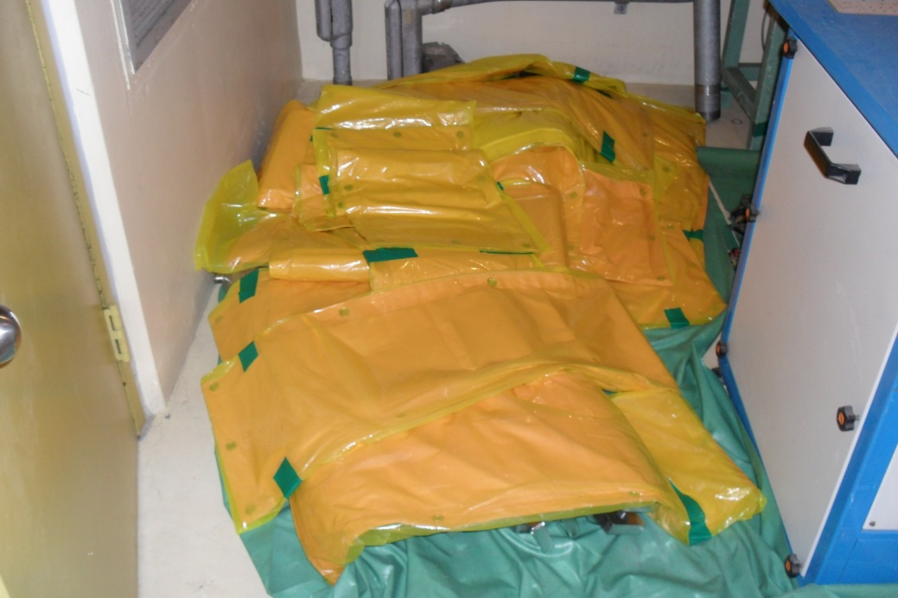
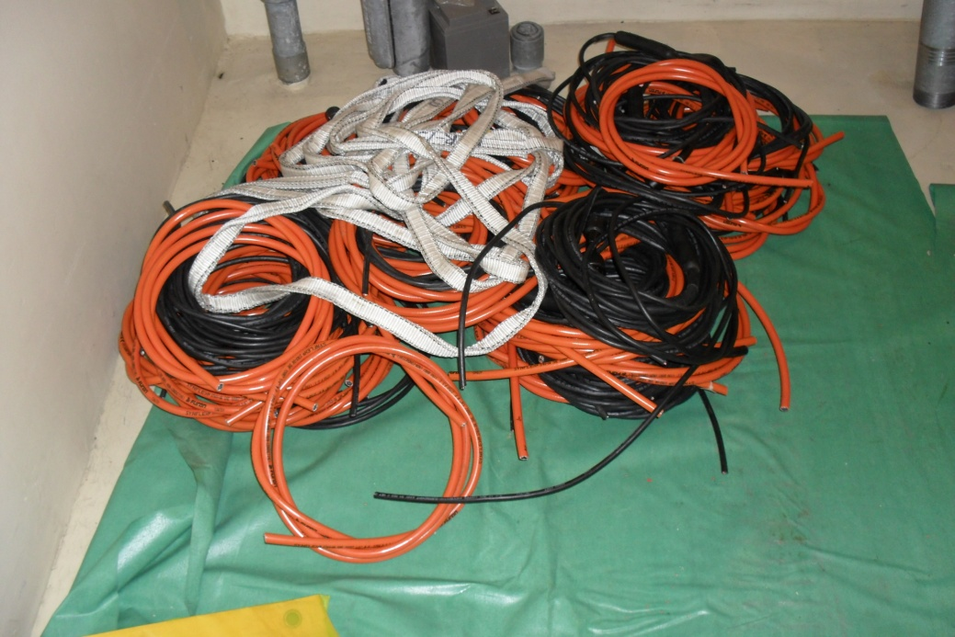
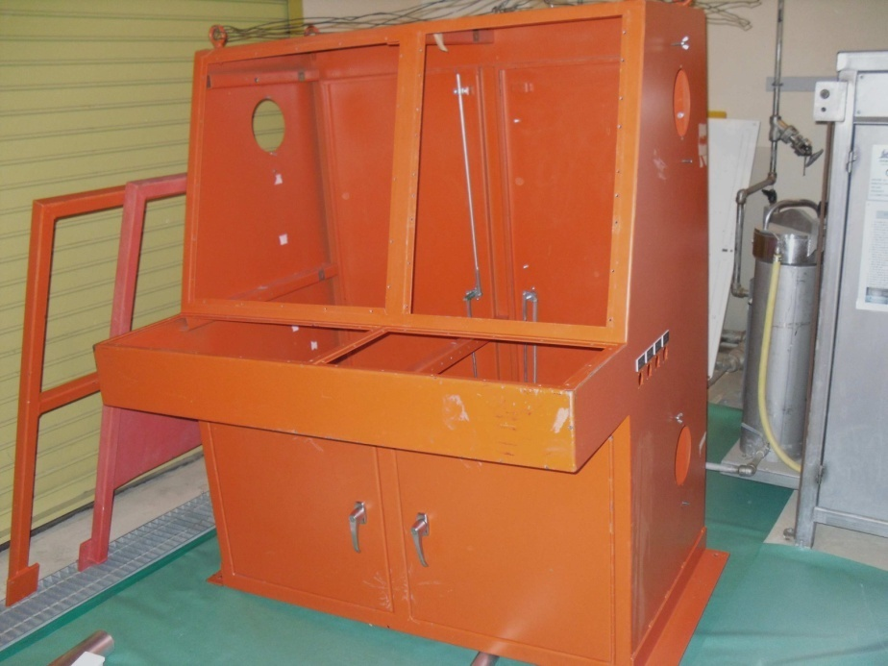
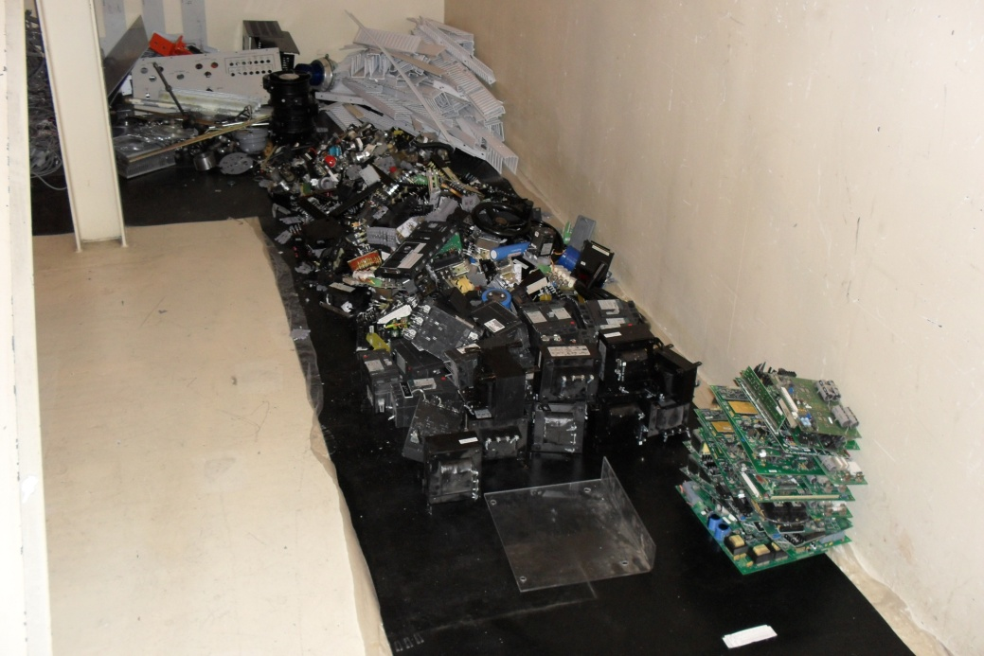
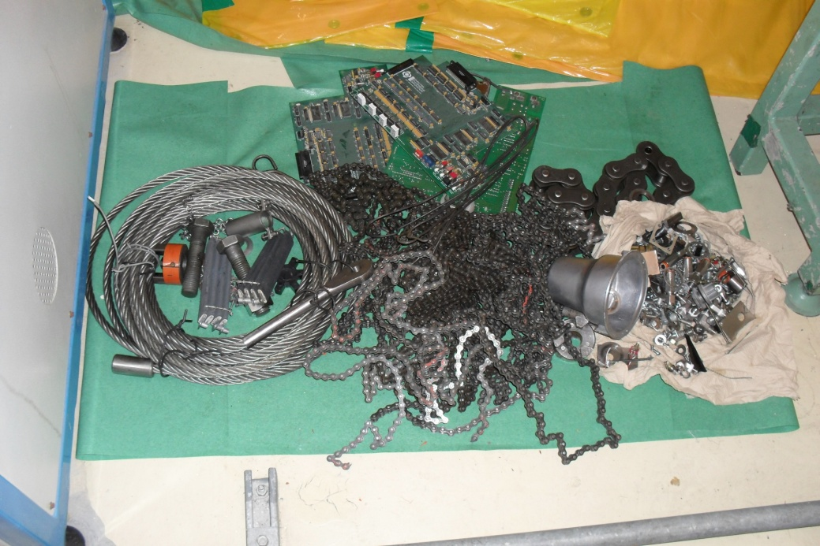
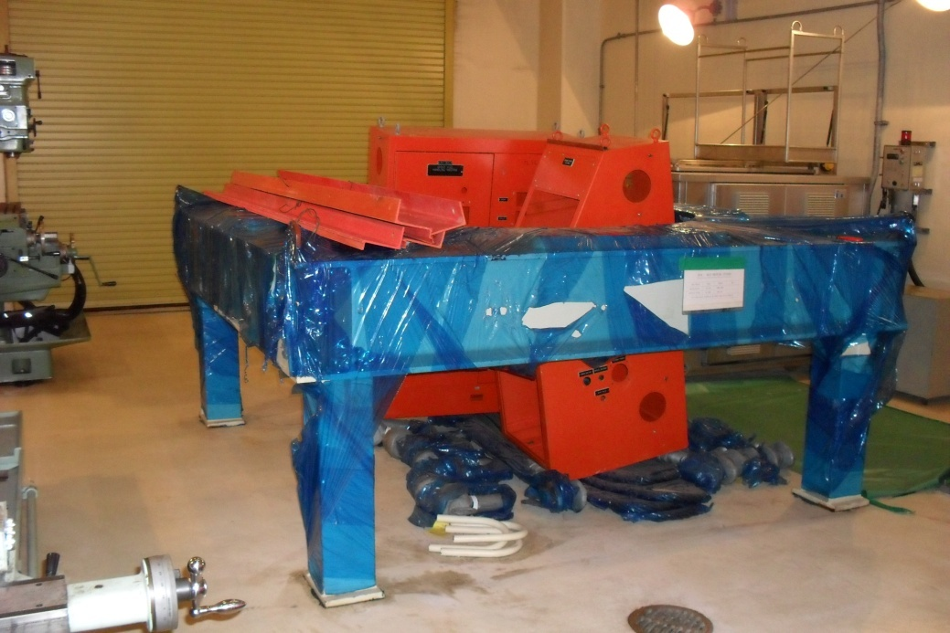
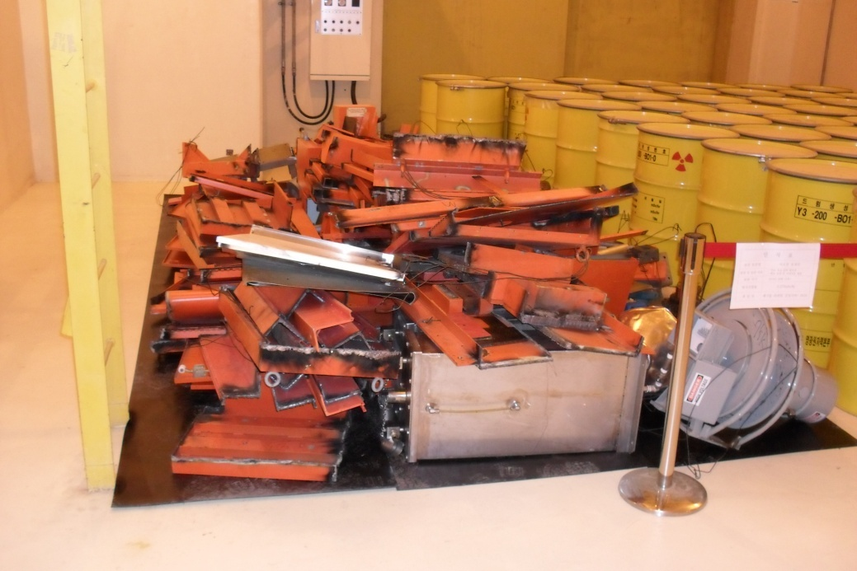
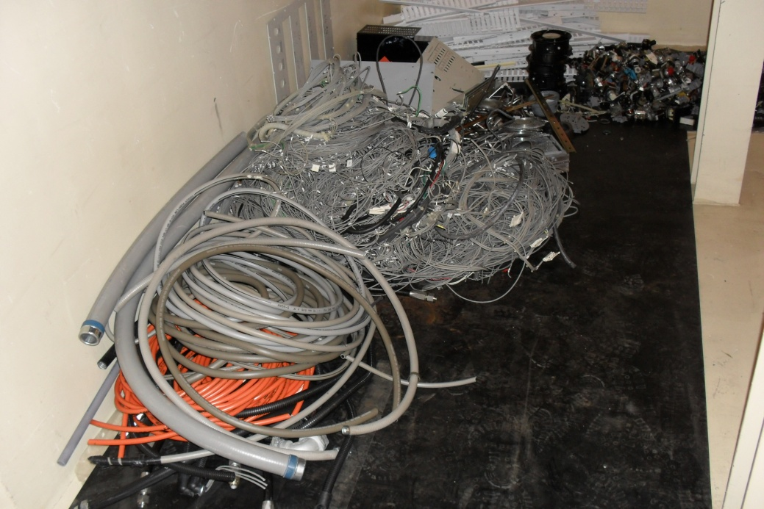
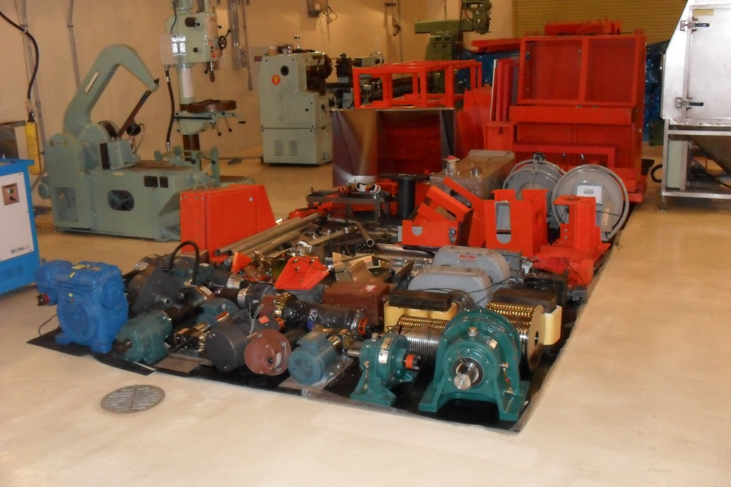
Main Examples - Real time management
CASE | Real time management | Remark
Iron from refueling Machine’s Improvement | ALARA Meeting before work Sorting by contamination level Separating Reusable parts Decontamination and cutting | before 6,016kg | After 616kg
 |  | Clean 5,400kg
decontamination
cutting
Sorting and drum

Slide 19
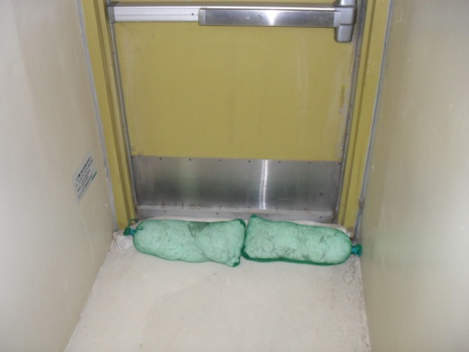
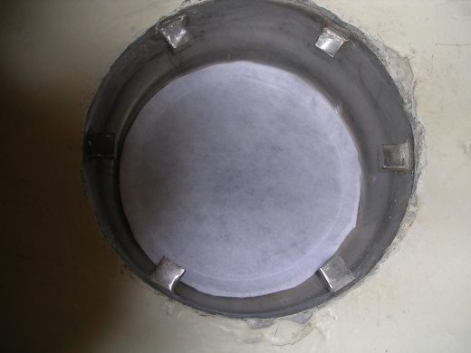
Main Examples - Real time management
CASE | Real time management | Remark
cleaning Paper | Reuse as possible | -
Gloves, socks | Reuse as cleaning & water sucking materials
Liquid Radwaste | Install Filter on floor drain - protecting foreign material in LRS
 | Separating Anticorrosive chemical water (CCW, Chiller) | -

Slide 20
Main Examples - Real time management
Separating Anticorrosive chemical water(CCW, Chiller)
Unnecessary for change of LRDPS Filling Material(Charcoal, Resin)
To past, Usually changed during Outage (design performance : 1.85E-1Bq/cc above)
Outage | Change | LRDPS Filling Materials |  |  |  | Remark
 |  | Charcoal (ℓ] | Resin [ℓ] | SUM (ℓ] | Drum [EA]
6–3th | '06. 2 ~ 5 | 9,400 | 10,188 | 19,588 | 98
5–4th | '06.10 ~ '07. 1 | 4,800 | 10,300 | 15,100 | 76 | Installation of MF/RO ( '06.11)
6–4th | '07. 6 ~ 9 | 1,200 | 5,500 | 6,700 | 34 | Separating RCS
5–5th | '08. 7 | 1,200 | 2,975 | 4,175 | 21
5–6th | '09. 9 ~ 12 | 2,400 | 7,200 | 9,600 | 48
6–6th | - | - | - | - | - | Performance(After Outage) - Activity N/D
Notes:
the effects of separating uncontaminated liquid water was excellent
To past we Usually changed LRDPS ---- ---- during
The amount of replacement was up to dozens of drums
But, this outage we did not change and the performance is very good untill now

Slide 21
Effects
Real time Analysis
Prompt Feedback
Wastes Reduction
Before Improvement | After Improvement
No idea of generation Source & Person | Identifying of causes and Feedback responsible management for generating person
Mixing and all dispose after works | Separating contaminated / uncontaminated Adequate decontamination according to Radioactive characterization
Poor in objective management because of Data less | Objective management & ALARA for wastes
Without Pretreatment of Liquid radwastes | Separating Liquid radwaste (CCW, Chiller, etc) Install filter on Floor Drain to prohibit foreign materials
Notes:
Now, I will summiarize the effects
By using this program and realtime management of radwaste
We could --- could have adequate
And we could --- and -----
-----
And we could saparate uncon liquid water
And we installed

Slide 22
Effects
Waste Reduction by Real-time management program
Dry Active Waste (DAW Drum) | plan | Result | Reduction Rate
 | 38 | 15 | 61
(Outage 2 times)
Reduction Rate Compared With
Plan : 61%
Wastes Deposit
40
Wastes Deposit +
Real-time management (Feedback)
Reduction Rate Compared With Previous Year : 64%
Notes:
we planed 38 drums in the beginning of outage but the result was 15
we reduced 61 % compare with plan
We ----- 64% ----- previous year

Slide 23
Effects
Costs reduction
Division | Details | Cost Reduction
Reduced DAW Drum | Reduced amount × disposal costs = 23Drum × $8,000 / drum | $184,000
LRDPS Filling Material (Charcoal + Resin) | 2009 Amount × disposal costs = 48Drum × $8,000 / drum | $ 384,000
SUM | $568,000 (without any payment for program development)

Slide 24
Future Plan
Improvement Of Main Radwastes Source
packing Vinyl Wrap (Reuse or water soluble PVA type )
Plastic Gloves (Mixed Type With Cotton and Rubber gloves)
Decontamination Paper (Reuse plan is Under conderation)
Objective management and ALARA For Radwaste Reduction
Video Production to inform and educate Waste Reduction
Period (Taking movie clips & photos) : 6th – unit 6
Program Upgrade for more convenience and practical use
More effective Management of Radwaste
various and interactive Analysis & Diagnosis
Graphical User Interface
Management Of Druming & radwaste Clearance
Related Imformations (exposure dose, regional radiation Rate, etc)
Notes:
In the future
We will improve main radwaste sources analyzed by this program
we will replace ----- ------ reuse
And now, we are able to carry out ---
And we are upgrading ---- --- by professional company
Now I will finish my presentation
Thank for your attention

Slide 25
Thank You

