Slide 1
Decontamination of Metal Radwastes using Machine Tools
2010. 07
Sunkwang Atomic Energy Safety Co.,Ltd.

Slide 2
CONTENTS
1. Introduction
2. Metal Radwastes
Status of Treatments
Technology Developments
3. Conclusions

Slide 3
1. Introduction
Framework
Generation of Metal Radwastes
Maintenance & Improvement of long-term operation NPPs
Treatment of Heavily Contaminated Metal Radwastes
Lack of effective decontamination due to hand tools
Requirement for Less Than Limits Disposal
Disposal regulations : The principles of IAEA/RS-G-1.7
Lack of processing technology for regulatory compliance
Improvement
Limits of using hand tools : Bulk handling difficulties
New technologies is required for bulk handling

Slide 4
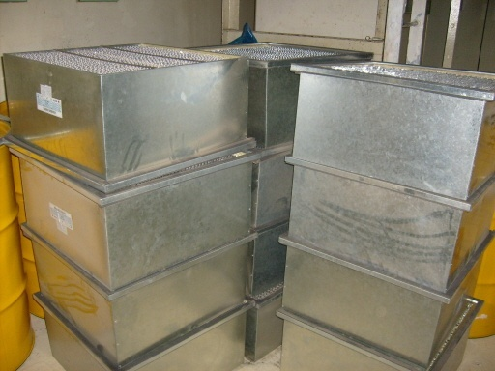
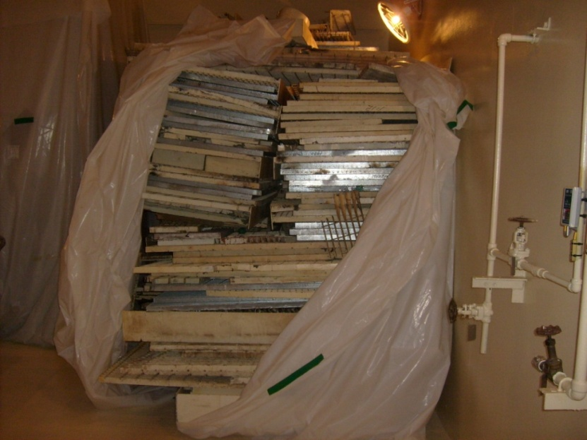
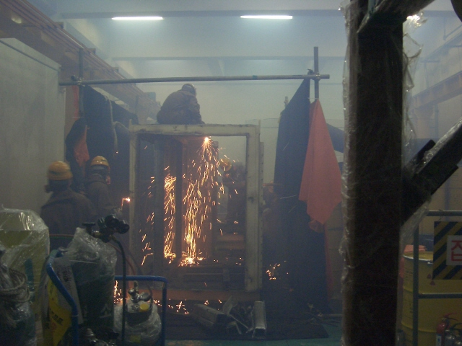
2. Metal Radwastes
2-1. Status of Treatments in Korea
Generation of Metal Radwasets from NPPs
Facilities Improvement
- reactor building and auxiliary building
Equipment Performance Improvement
- air and water purification systems
Replace Aging Facilities
- various waste materials, grating, library, etc.

Slide 5
2. Metal Radwastes
Generation of Metal Radwaste Drum
Amounts of drums
Average of about 200 drums occurred in last three years
Increased volume of its disposal due to recycle activation
(units: drums)
Year Unit | 2007 | 2008 | 2009 | 2010 (July)
#1 | 247 | 136 | 95 | 3
#2 | 56 | 67 | 24 | 1
Total | 303 | 203 | 119 | 4

Slide 6
2. Metal Radwastes
Storage of Metal Radwastes
Managements
Unit
Item
Amount
(tons)
Location
Remarks
#1
Air conditioning system, Toolbox
12
M-3
Decontamination
Steel beam, Others
10
M-3
Storage
RCP Main Flange Bolt
2
M-3
Storage
#2
Dryer, Fan housing
1.4
N-3
Decontamination
Total
-
25.4
-
-

Slide 7
2. Metal Radwastes
Treatments
1. Drum Storage
Impossible to decontaminate metal radwastes
After pretreatment and volume reduction
2. Attenuation Storage
Long half-life radionuclide contaminated large facilities
Complex geometry metal radwastes
3. Temporary Storage
Its disposable metal radwastes (by level, type)
Decontamination after temporary storage

Slide 8
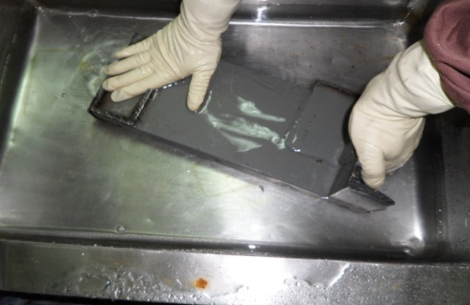
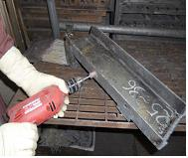
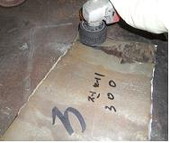
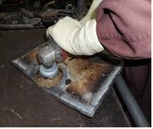
2. Metal Radwastes
Decontamination
General contamination
- After scrubbing, then high pressure steam or water cleaning
Heavy contamination
- After grinding (0.1~0.2 mm), then high pressure steam cleaning

Slide 9
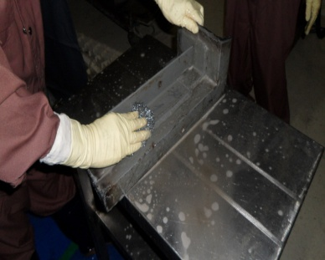
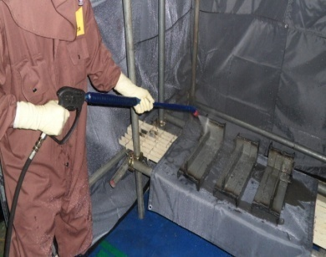
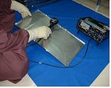
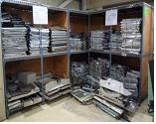
2. Metal Radwastes
Its Disposal Process
Transportation
(Decontamination site)
Decontamination
Scrubbing
High pressure steam
Radiation measurements
Classification and Numbering
High pressure watering
Grinding
Analysis and Packaging
Transportation
(Its disposal storage site)
Measurements
Packaging & Storage

Slide 10
2. Metal Radwastes
Comparison of its disposal regulatory standards
Nuclide | Concentration limit (Bq/g) |  |  | MDA (Bq/g)
 | MOEST Notice/Korea | KINS | IAEA
Co-60 | Personal: 10μSv/year Groups: 1man-Sv/year proved less concentration | 0.1 | 0.1 | 0.01
Cs-137 |  | 0.1 | 0.1 | 0.01
H-3 | 100 | 100 | 100 | 10
C-14 | 100 | 0.1 | 1 | 0.1

Slide 11
2. Metal Radwastes
Decontamination issues
Hand tools grinding problems
1
Long time for working
2
Work processes delay due to add sticking
3
Not suitable for long-term operation of large quantities
4
Absence of mechanical equipment for cutting metal surface
5
Low efficiency and very dangerous for working

Slide 12
2. Metal Radwastes
2-2. Technology Developments
Needs
To overcome the limitations of existing methods
To improve the working environment
To reduce the working time
To reduce costs and perform an efficient process

Slide 13
2. Metal Radwastes
The purpose of technology development
Decontamination of Metal Radwastes using Machine Tools
Technology Developments
Optimal process
Improve efficiency
Expanded
its disposal
Reduction
Radwastes

Slide 14
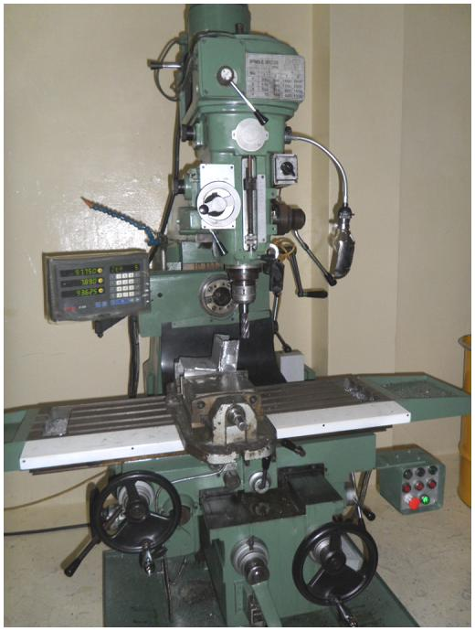
2. Metal Radwastes
Configuration of equipments
Column
Milling machine units with base
Knee
Vertical adjustment of the table
Saddle
Table supported/Back and forth adjustment
Table
Fixed workpiece/Horizontal adjustment
Over Arm
Abber supporter supported

Slide 15
2. Metal Radwastes
Specification / NSM-T
Size : 1,950mm(L) ⅹ 1,800mm(W) ⅹ1,950mm(H)
Power : 220V, 60Hz, 3-phase
Main part Specification
Item | Detail | Unit | Value
Table | Working space | mm | 1,100ⅹ280
 | Maximum move distance/horizontal | mm | 820
 | Maximum move distance/back and forth | mm | 360
 | Maximum move distance/vertical | mm | 450
 | Maximum weight of workpiece | Kg | 250
Column | RPM | RPM | Vertical 75~3,600 Horizontal 90~1,400
 | Vertical move distance | mm | 140
Equipment weight |  | kg | 2,300

Slide 16
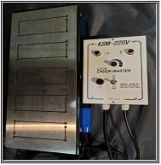
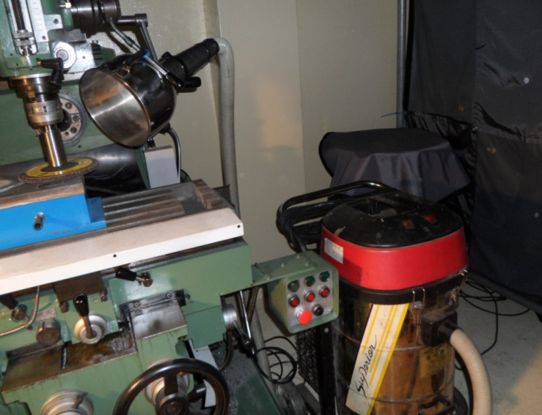
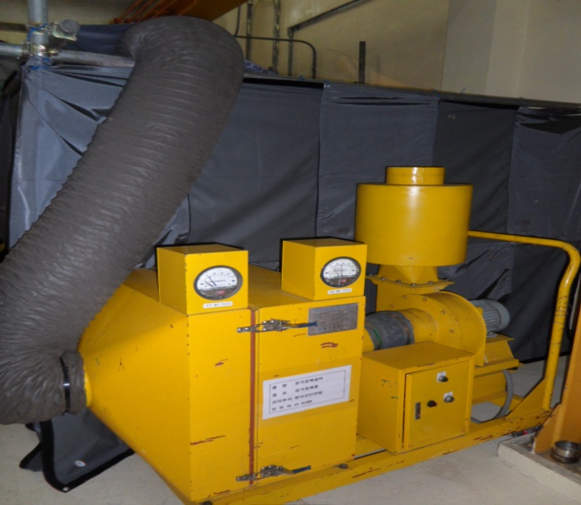
2. Metal Radwastes
Major parts facility
Magnetic chuck
Dust collector
Air Purifier

Slide 17
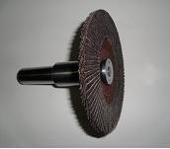
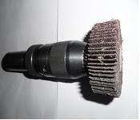
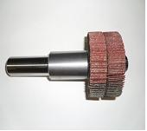
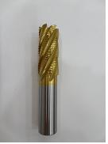
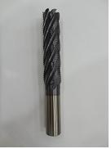
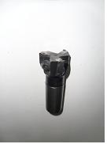
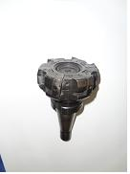
2. Metal Radwastes
Application tooling
For grinding
7” Disk wheel paper
2” and 4” Disk wheel paper
For milling
Ø25 End mill
Ø30 Long end mill
Ø50, Ø100 Face mill cutter

Slide 18
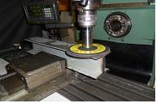
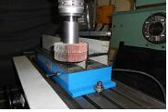
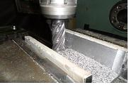
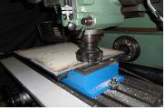
2. Metal Radwastes
How to apply
Grinding
Vertical and horizontal grinding with 4”, 7” disk wheel paper : 400mm/min(0.2mm)
Milling
Vertical milling with Ø30 long end mill : 240mm/min(0.3mm)
Horizontal milling with 2”, 4” face mill : 300mm/min(0.3mm)

Slide 19
2. Metal Radwastes
Actual Operation

Slide 20
2. Metal Radwastes
Before and after comparison
Working time and milling rate
Item | Workpiece | Area (m² ) | Time (min.) | Thickness (mm) | Avg. Rate (m² /min.)
Hand tools (Grinding) | Plate1 | 0.36(60x30) | 36 | 0.1~0.2 | 0.01
 | Beam2 | 0.54(15x60) | 54
NSM-T (Grinding) | Plate3 | 0.36 | 9 | 0.1~0.2 | 0.04
 | Beam4 | 0.54 | 13.5
NSM-T (Milling) | Plate5 | 0.36 | 12 | 0.3 | 0.03
 | Beam6 | 0.54 | 18
※ Preparation processes are excluded when working time calculating

Slide 21
2. Metal Radwastes
Changes in work efficiency
* Average standard area;0.45m²
Working Time
Rate
(min.)
(m²/min)
49.5
0.04
0.03
15
11.3
0.01
Hand tools
NSM-T
(Grinding)
NSM-T
(Milling)
Hand tools
NSM-T
(Grinding)
NSM-T
(Milling)

Slide 22
2. Metal Radwastes
Comparison of waste generation
Size : 60*30cm , 10t
Volume : 1.8ℓ
Thick : 0.1~0.2mm
Wastes : 0.2ℓ
Size : 60*30cm, 10t
Volume : 1.8ℓ
Thick : 0.1~0.2mm
Wastes : 0.2ℓ
Size : 60*30cm, 10t
Volume : 1.8ℓ
Thick : 0.3mm
Wastes : 0.3ℓ
Hand Tools
Grinding/NSM-T
Milling/NSM-T
Use waste drum pore filler

Slide 23
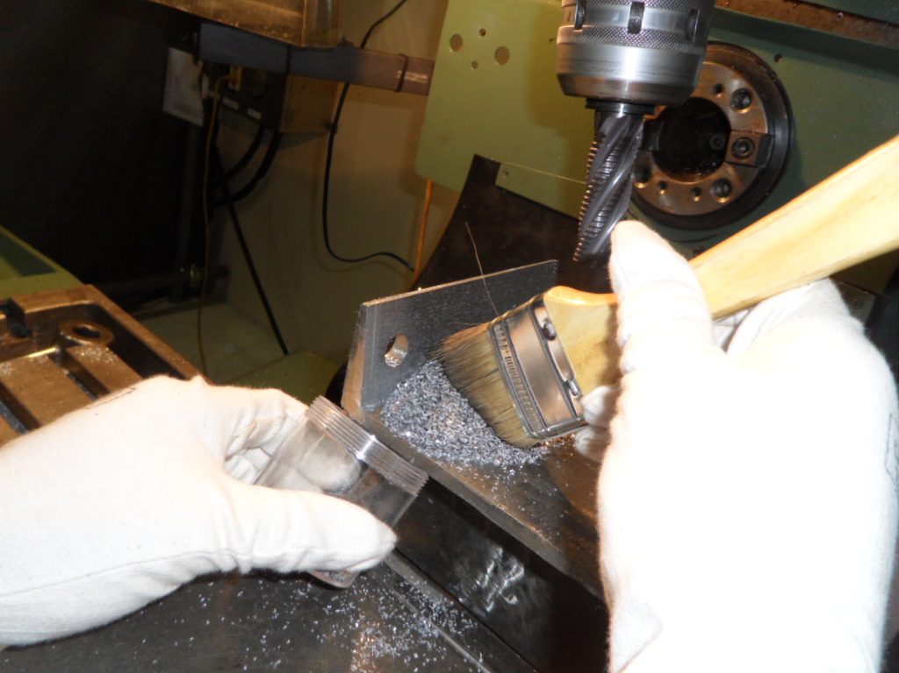
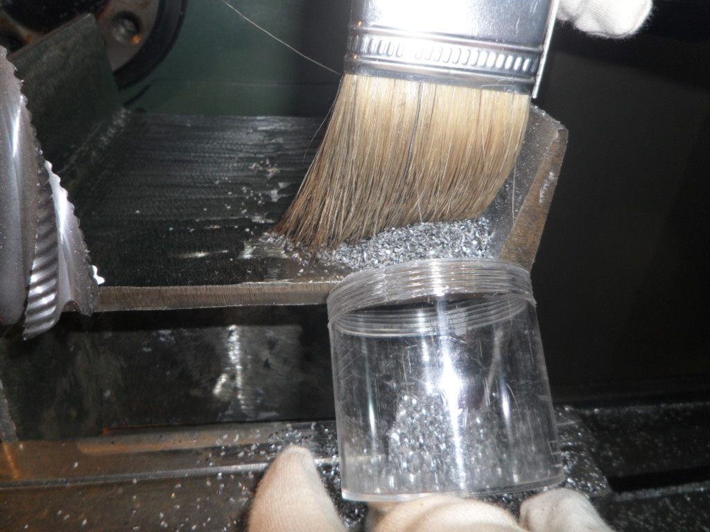
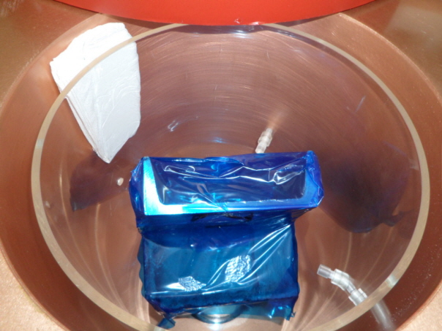
2. Metal Radwastes
Radioactivity Analysis
Item | Workpiece | Contamination (Bq/cm²) |  | Concentration (Bq/g) |  | Grinding, Milling (mm)
 |  | before | after | before | after
Hand tools (Grinding) | Plate1 | 1.11 | BKG | 2.48E-02 | N/D | 0.1~0.2
 | Plate2 | 1.18 | BKG | 2.24E-01 | 1.09E-02
 | Beam3 | 1.48 | BKG | 2.64E-02 | 1.27E-02
NSM-T (Grinding) | Plate4 | 0.56 | BKG | 2.21E-02 | N/D | 0.1~0.2
 | Plate5 | 1.11 | BKG | 3.01E-02 | N/D
 | H Beam6 | 0.74 | BKG | 2.37E-02 | 1.33E-02
NSM-T (Milling) | Plate7 | 0.48 | BKG | 1.03E-02 | N/D | 0.3
 | Plate8 | 1.85 | BKG | 3.12E-01 | N/D
 | Beam9 | 0.44 | BKG | 4.03E-02 | N/D
※ Surface contamination meter : Frisk-Tech
Radionuclide Analyzer : HpGe Gamma nuclides Analyzer

Slide 24
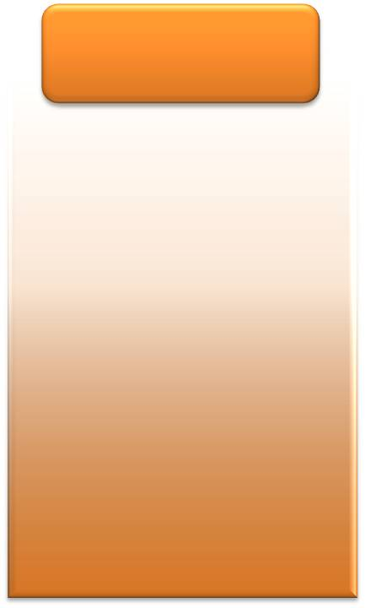
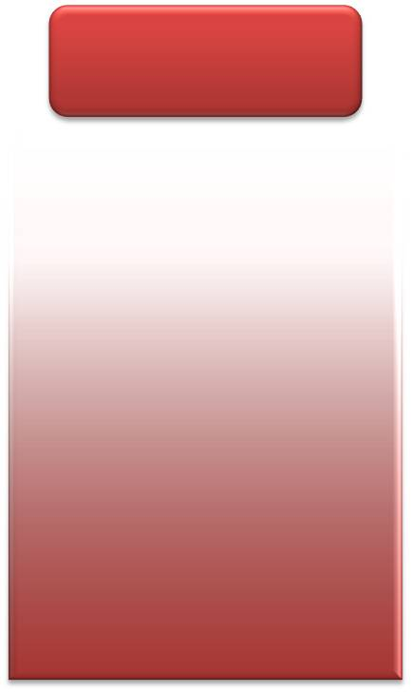
2. Metal Radwastes
Changes in contamination
Hand Tools
Grinding/NSM-T
Milling/NSM-T
1.26
0.92
0.80
0.09
0.12
BKG
0.01
BKG
0.03
0.01
BKG
N/D
Contamination Concentration
Contamination Concentration
Contamination Concentration
※ units : contamination(Bq/cm²), concentration(Bq/g)

Slide 25
2. Metal Radwastes
Process after improvement
Step. 8
Step. 7
Step. 6
Step. 5
Heavy
Analysis
Steam jet
Grinding, Milling
Step. 4
Fixed object
Step. 3
Step. 2
Step. 1
Normal
Measurements
Cleaning
Scrubbing
Pretreatment

Slide 26
2. Metal Radwastes
Advantages and disadvantages
Advantages
Disadvantages
Irregular cross-section
Easy to handle
Contaminants adhere
Reduce workspace
Hand Tools
Increased worker fatigue
Various shapes application
Massive dust
Suitable for paint removal plane
Ability to master
Large amounts handling
Machine Grinding
Limited workspace
Regular cross-section
Depending on shapes
Reduced working time
Dust generation
Small dust
Ability to master
Large amounts handling
Machine Milling
Pretreatments need
Reduced working time
Limited workspace
Adjustable milling thickness
Depending on shapes

Slide 27
2. Metal Radwastes
Application effects
Decontamination process optimization for metal radwastes
To expand its disposal contribute to reducing radwastes
Measuring of surface cutting depth and decontamination of heavy contaminant on irregular surfaces
Increase operational efficiency by continuous treatment with large amounts of metal radwaste
Decrease production of drum by waste recycling (disposal costs reduced)

Slide 28
2. Metal Radwastes
Quantitative effects
Purchase of drum
Drum treatment costs
50drums X 74,000won/drum = 3,700,000won
34,108,500 won
Labor
50drums X 608,170won/drum = 30,408,500won
Drum disposal costs
Disposal costs
50drums X 3,853,000won/drum = 192,650,000won
224,525,000 won
Disposal fee
50drums X 637,500won/drum = 31,875,000won
Steel recycling costs
Steel recycling
263,193,500won
Reduction
4,560,000 won
12,000kg X 380won/kg = 4,560,000won
Reducing costs and cash equivalent drum: handles steels 12 tons (average 250kg/drum)

Slide 29
2. Metal Radwastes
Qualitative effects
Radwaste reduction and treatment technology established
Additional secure storage space for temporary storage
Improve the drum treatment and care level by applying
the entire company
Recycling of resources to contribute to the development of
green industries

Slide 30
2. Metal Radwastes
Development Schedule
Planning and Performance
Planning
Performance
Promotion details | 2010 year |  |  |  |  |  |  |  |  |  | Rate (%)
 | 03 | 04 | 05 | 06 | 07 | 08 | 09 | 10 | 11 | 12
Project Selection |  |  |  |  |  |  |  |  |  |  | 100
Market Research |  |  |  |  |  |  |  |  |  |  | 100
Apply Test |  |  |  |  |  |  |  |  |  |  | 100
Equipment Installation |  |  |  |  |  |  |  |  |  |  | 100
Field Demonstration |  |  |  |  |  |  |  |  |  |  | 100
Equipment operating |  |  |  |  |  |  |  |  |  |  | -

Slide 31
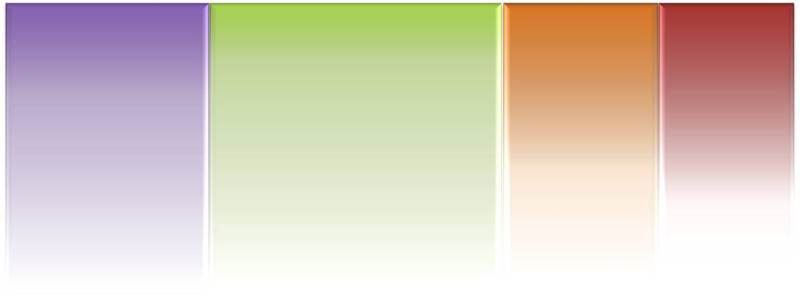
2. Metal Radwastes
Human Resources and Budget
Team Leader
Seung Chun Lee
Manpower
Team
Team
Team
Dae Seong Jang
Byeong Jin Gu
Gyeong Man Gu
Item
Detail
Amount(won)
Remarks
Budget
Equipment
Milling machine
18,000,000
-
Supplies
Application tooling
3,400,000
-
Additional expenses
Auxiliary tools
2,500,000
Scheduled
Other expenses
Market research and training
1,200,000
-
Total
-
25,100,000

Slide 32
3. Conclusions
Decrease production of drum by increasing its disposal
Efficiency and Environment Improvement by Optimal operation
Decontamination Process Standardization of its disposal metal radwastes
Applied to various types of devices to reinforce and expanded device
Metal hybrid decontamination techniques used and improved processing techniques

Slide 33
Thank you for your attention!!!
Sunkwang Atomic Energy Safety Co. Ltd.

