Slide 1

Improvements of ADR System
August 30, 2010
Ulchin NPP units 5&6

Slide 2

Contents
Ⅰ. Brief Overview of ADR System
Ⅱ. Existing problems
Ⅲ. Lessons learned from the use of ADR Sys.
Ⅳ. Contents of improvement
Ⅴ. Effects

Slide 3
Ⅰ. Brief Overview of ADR System
1. Main function of ADR(Automatic Dose Reader) Sys.
Access Management
Of Radiological
Controlled area
Worker’s information
Entrance date
ADR , TLD No. etc
Management of
RWP
ERWP (Extended Radiation Work Permit)
RRWP (Regular Radiation Work Permit)
SRWP (Specific Radiation Work Permit)
Radiation dose
management
Personnel dose management
Collective dose management
Regular dose management

Slide 4
Ⅰ. Brief Overview of ADR System(Cont.)
2. Entrance procedure
To enter
Register
radiation worker
Issue RWP
Take ADR
Enter RCA
• Radiation Protection
Training
• Whole Body Counting
• Medical Exam
• Issue TLD
• ERWP
• RRWP
• SRWP
• Identification
• Setting alarm for
alarm limit
• Reader(Entrance)
- ADR/TLD scan
- Select RWP
- Notice
• Open Turnstile
To exit
After
work
• ADR Reader(Exit)
• Portal Monitor
Exit
• ADR dose information
• Contamination
• Entrance and exit details
• Gate Open

Slide 5
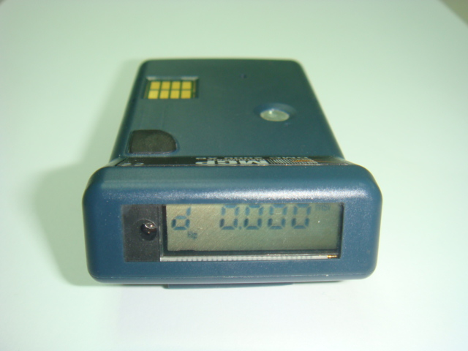
Ⅰ. Brief Overview of ADR System(Cont.)
3. ADR(Automatic Dose Reader) Function
Picture | Characteristic
 | ● Direct reading(real time reading) ● Displaying dose , dose rate ● Generating audible & visual alarms

Slide 6
Ⅱ. Existing problems
1. Inconvenience and confusions due to multi-access
steps for entrance
Insert ADR &
scan TLD
Enter
Push “ENTER “
button twice(1 RWP )
Input RWP No.
(If more than 2 RWPs exist )
Push “ENTER “
button twice

Slide 7

Ⅱ. Existing problems(Cont.)
2. User’s inconvenience due to inputting RWP No.
Ex) RWP No. : 2010-5-E-0069
3. Occurrence of system errors with turnstile (In 2006)
Turnstile error : 72 times (reading error of photo sensor)
Communication error: 56 times (Between Reader and PC)

Slide 8
Ⅱ. Existing problems(Cont.)
4. RWP No. input errors (if more than 2 RWPs exist)
Inaccurate dose statistics with allocated tasks due to input errors on RWP No.
During O/H in 2006 : 540 times (#5: 293, #6: 247)
Operation period in 2006 : 56 times (#5: 37, #6: 19)
Man power lost to correct RWP No. errors

Slide 9
Ⅱ. Existing problems(Cont.)
5. Increasing purchase costs
Difficulties in operation & maintenance
Manufacturer : foreign supplier
Purchase costs Increase due to a monopolistic* supplier
* a monopolistic : in business it tries to control as much of an industry
as it can and does not allow fair competition.(독점적인)
Not easy for maintenance

Slide 10
Ⅱ. Existing problems(Cont.)
6. LCD (4 Lines, 20 Characters per line) was too small to
display all the information that workers need to know
Check ADR Sys.
in H.P Room
ADR
Reader
Check RWP No.
in Radiation
information
system
Inform
-ation
on
Worker
If more
Than
2RWPs
Check
Personnel
Information
in DREAMS
Check RWP
No. to H.P

Slide 11
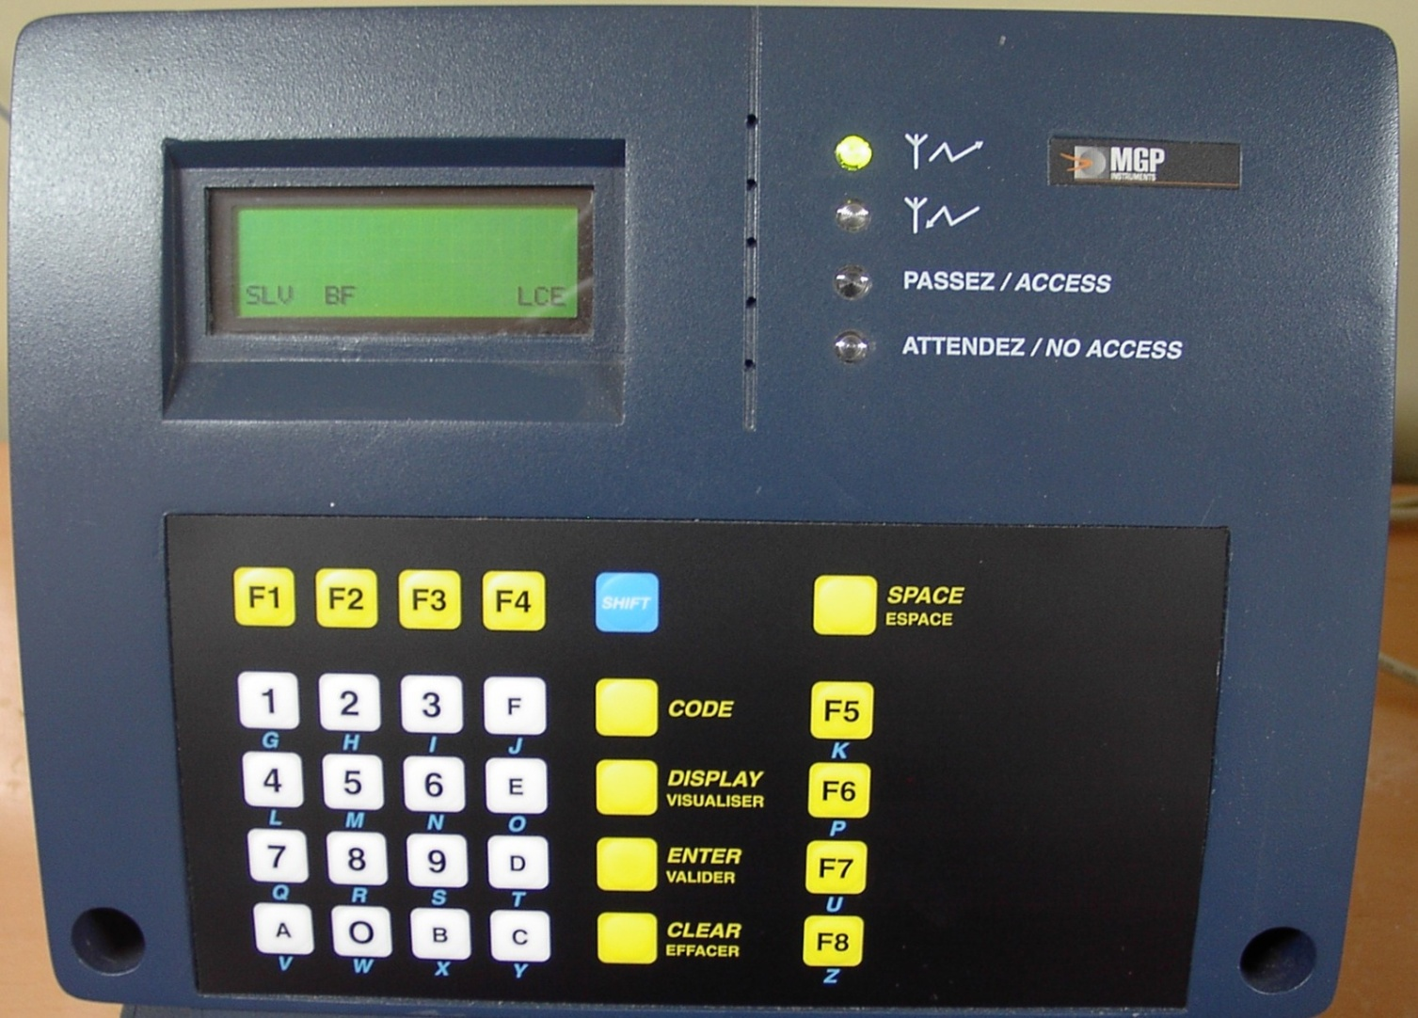
Ⅱ. Existing problems(Cont.)
Existing LCD picture(old model)

Slide 12
Ⅱ. Existing problems(Cont.)
7. ADR System errors(turnstile & data transmission)
Turnstile sensors sometimes were not recognized exactly.
Using the hardwire cable between PC and Reader caused
many data transmission errors.

Slide 13
Ⅲ. Lessons learned from the use of ADR Sys.
1. To reduce ADR system failures and errors
2. To be convenient for users to access
3. Easy maintenance and cutting costs
★ New ADR System has been adopted from March,
2007

Slide 14
Ⅳ. Contents of improvements
1. Simplifying steps for easy access
Before | After
● Scan ADR & TLD ● Push “ENTER” button twice ● Confirm RWP No. and input RWP No. (if more than 2 RWPs exist) ● Enter radiological controlled area | ● Same as “Before” ● None ● Select the RWP shown on the touch screen ● Enter radiological controlled area

Slide 15
Ⅳ. Contents of improvement(Cont.)
2. Redesign of displaying system for additional
information about radiation worker
Before | After
● None. but worker’s RWP No. | ● Developed program to display most of information on the wide LCD screen - Worker’s radiation dose history - Protective equipments requirement - RWP, WBC, etc.

Slide 16
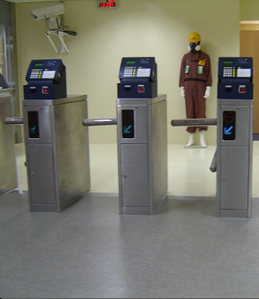
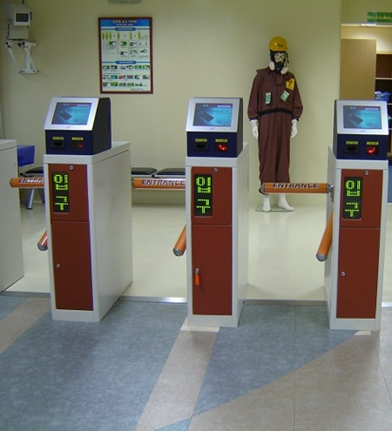
Ⅳ. Contents of improvement(Cont.)
Redesign small LCD to the wide touch screen
Before
After

Slide 17
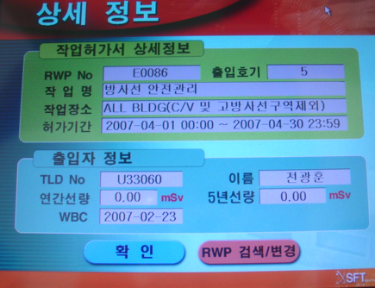
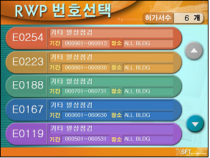
Ⅳ. Contents of improvement(Cont.)
RWPs & Individual information on worker

Slide 18
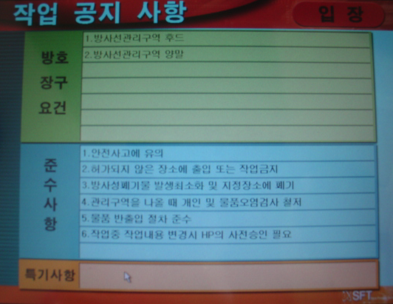
Ⅳ. Contents of improvement(Cont.)
Specific requirements and notices for radiation safety

Slide 19
Ⅳ. Contents of improvement(Cont.)
3. Making system error and failure to zero
Before | After
● 4 sensors inside turnstile ● Use of a hardwire cable between PC and Reader | ● Added 2 photo sensors for exact acknowledge ● Changed to LAN

Slide 20
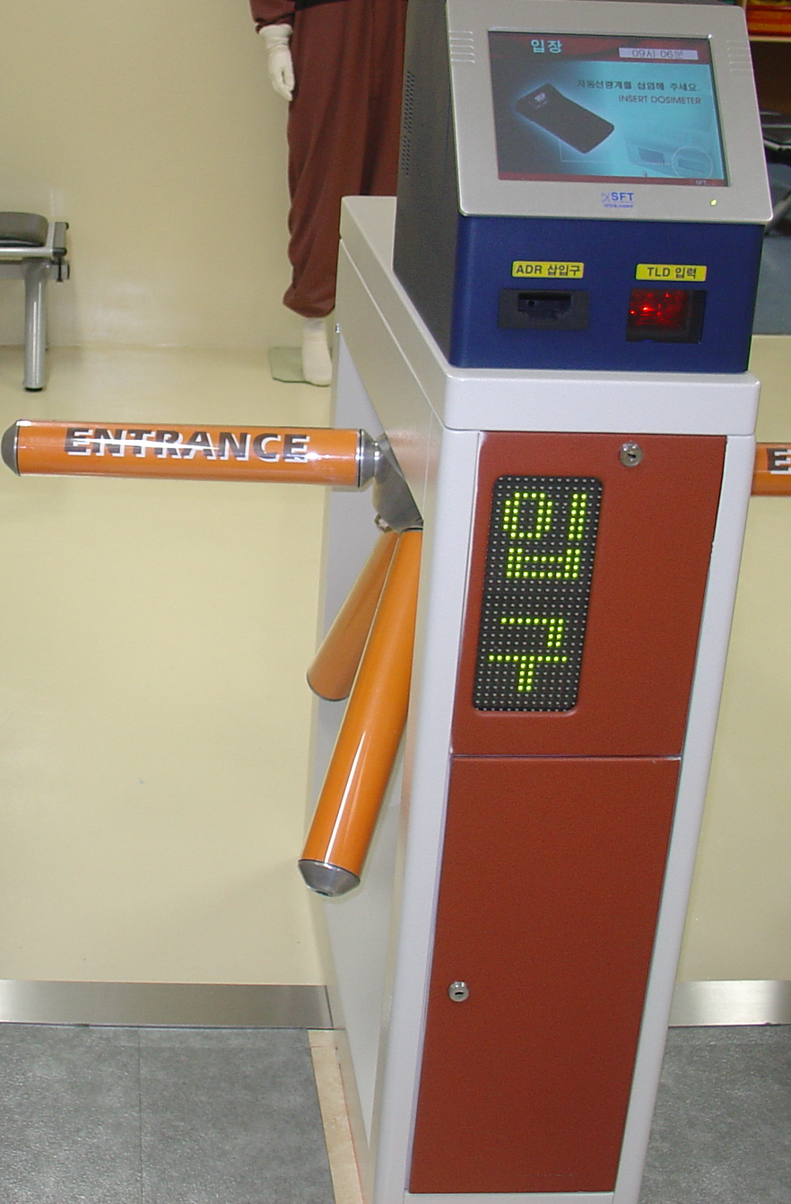
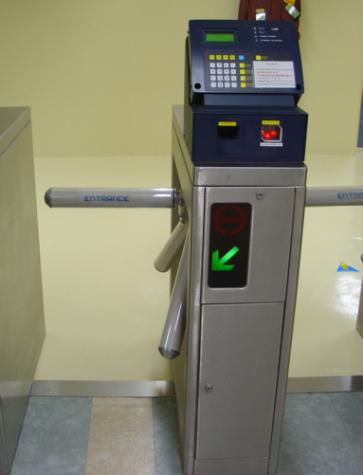
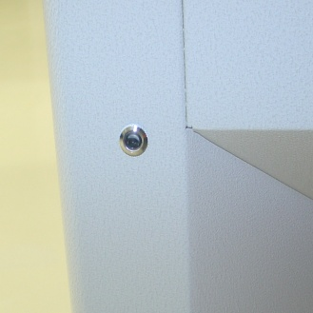
Ⅳ. Contents of improvement(Cont.)
No access errors after adding photo sensors
Sensor
Before
After

Slide 21
Ⅳ. Contents of improvement(Cont.)
4. Convenience of maintenance & Cost reduction
Before | After
● Difficulties in repair and normalization of ADR system because of foreign supplier ● Caused the price of ADR system and spare parts to keep being high | ● Localization of ADR system resulted in prompt maintenance supports from domestic supplier and decreased purchase price including cost for maintenance

Slide 22
Ⅴ. Effects
1. Enhancement of system reliability
Item | Before (2006) | After (2007~2010)
System communication error | 12 | 0
Turnstile sensor error | 18 | 0
Input error of RWP No. | 56 | 0

Slide 23
Ⅴ. Effects(Cont.)
2. Cost reduction
◆ Ulchin units 5, 6 (for ten years)
(Unit : US$)
Item | Purchase Cost |  | Cost Reduction
 | Before | After
● Cost of purchase - ADR system S/W(1set) - ADR reader(20ea) ● Cost of Maintenance | 50,000 360,000 100,000 | 7,200 260,000 50,000 | 42,800 100,000 50,000
Total | 510,000 | 317,200 | 192,800
● Cost Reduction /year : 192,800,000Won / 10years
≒ 19,280 US$ / year

Slide 24
Ⅴ. Effects(Cont.)
3. Additional effects
User’s satisfaction due to simplified access step through ADR sys.
Enhanced efficiency of radiation safety management
by providing prompt information for radiation safety
No extra man power to correct the input errors, i.e. RWP No.
Localization of ADR system ensured secure supply

Slide 25

Thank You for your attention!!!
25/25

Slide 26


