Slide 1
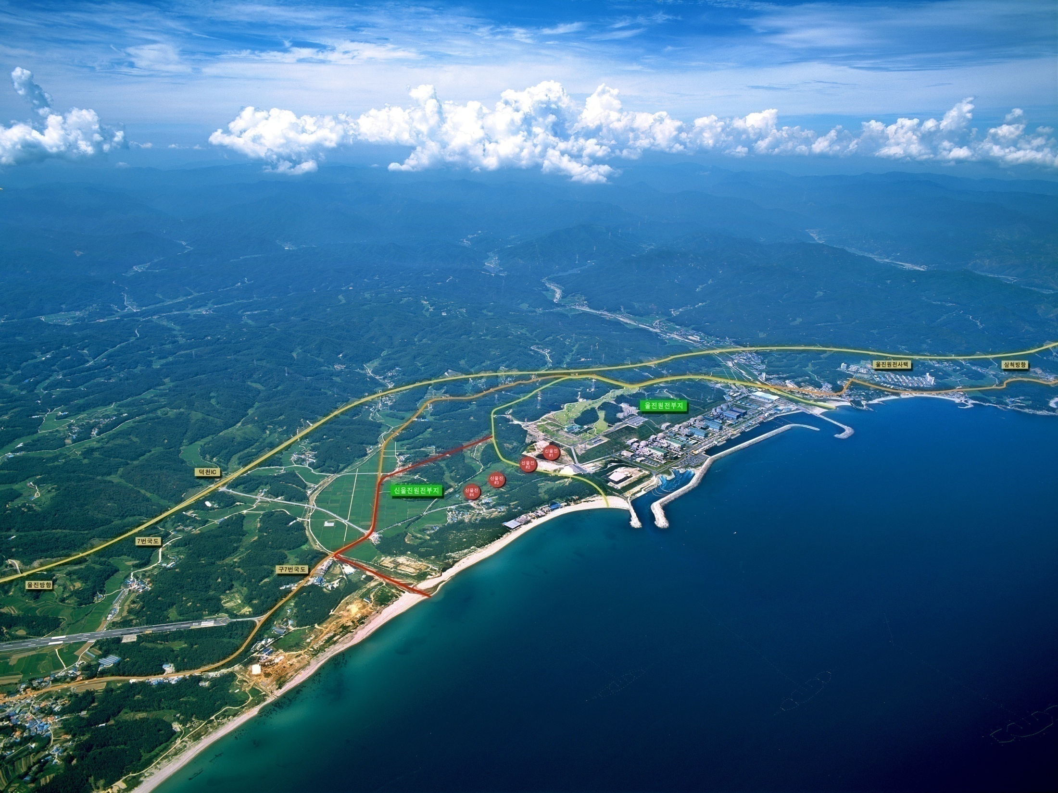
Operation of Remote Monitoring &
Video telephony System
for Advanced Radiation Protection
K H N P
Weon-Seob Yoon
Manager, Radiation Safety Team
ULJIN NPP 1
Notes:
Good afternoon, ladies and gentleman.
My name is Weon-Seob Yoon, and I am Manager of Radiation Safety Team at ULJIN Nuclear Power Plant unit 1&2 of KHNP.
I am in charge of radiation protection.
This presentation topic is “Operation of Remote Monitoring & Video telephony System for Advanced Radiation Protection”.
The purpose of today`s presentation is to introduce you to RMVS, which can implement remote and real time radiation protection.
This presentation will take about 20 minutes, and I will take any questions that you may have at the end of the presentation.

Slide 2
Contents
Ⅰ
Primary Problems of Existing Radiation Protection
Ⅱ
Features of Operating RMVS
Ⅲ
Benefits of Operating RMVS
Notes:
Let me run you through the agenda.
This presentation is in three parts.
First on the agenda is primary problems of existing radiation protection.
Secondly, I will introduce to features of operating RMVS.
Final is benefits of operating RMVS.

Slide 3

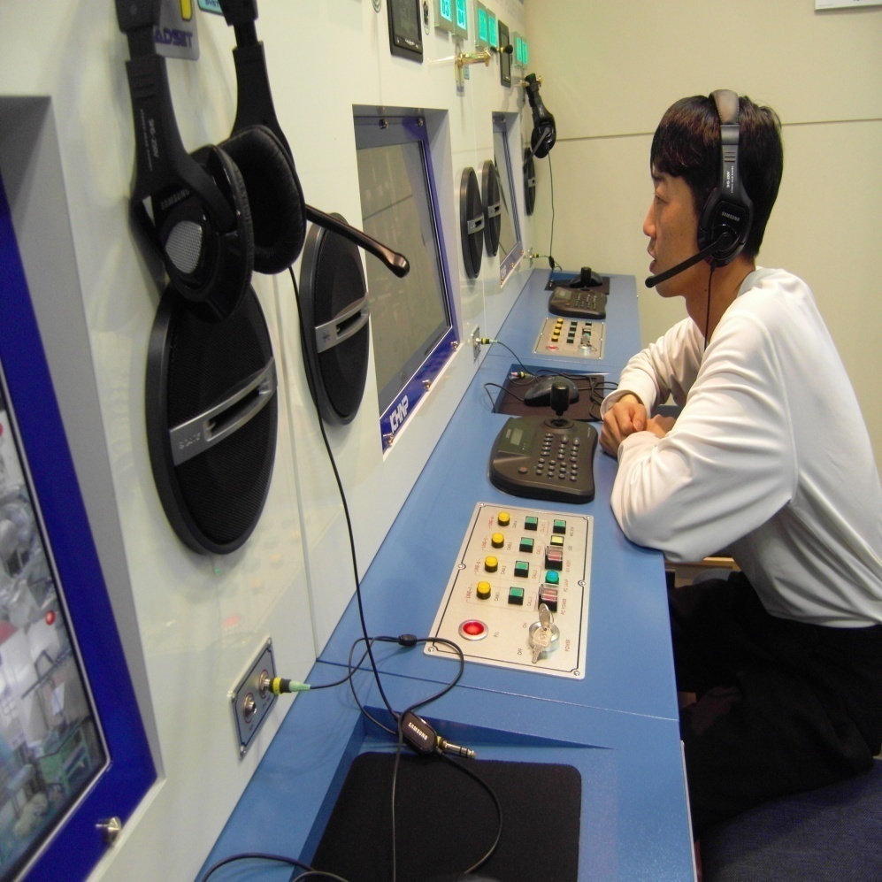
Ⅰ. Primary Problems of
Existing Radiation
Protection
Notes:
Part 1, Primary problems of existing radiation protection.

Slide 4
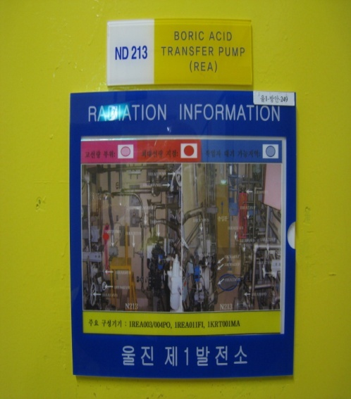
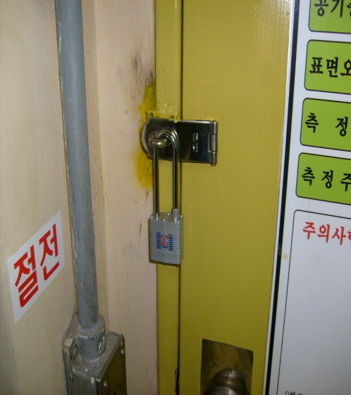
Ⅰ . Primary Problems of Existing Radiation Protection
1. Radiation Protection before Operating RMVS
High Radiation Area
√ Entrance Control after Locking Restricted Area
√ Attachment of Radiation Information Directory on Entrance Door
√ Installation of Lead Shield at High Radiation Equipments/Pipings
√ Holding of Pre-job Briefing
√ Routine Survey
√ Attendance of RP Technicians at Field Works in High Radiation Area
☞ Radiation Protection for Simultaneous & Multiple Works
☞ Measurement of Radiation Dose Rate/Surface Contamination Level/Air
Contamination Level
Notes:
Firstly, I would like to explain the radiation protection for High Radiation Area before operation of RMVS.
We have controlled entrance of the restricted area by locking, and attached radiation information directory on the entrance door.
In addition, we have installed lead shields at high radiation equipments/pipings, and hold pre-job Briefing for important maintenance, and implemented routine survey.
Finally, we have RP Technicians attended field works in High Radiation Area and implemented radiation protection for simultaneous-multiple works and measured radiation dose rate/surface contamination level/air contamination level.

Slide 5
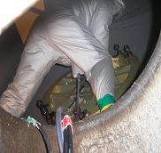
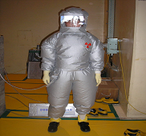
Ⅰ . Primary Problems of Existing Radiation Protection
1. Radiation Protection before Operating RMVS
Installing/Removing Nozzle Dam of Steam Generator
√ Mock-up Training for Rehearsal of Real Works
√ Main Workers Enter inside S/G to Install & Remove Nozzle Dam
√ Supervisors Control Main Workers at the Entrance of S/G Man-Way
√ It`s Possible to be given Information of S/G Interior only by
Main Workers
√ It`s Impossible RP Technicians to Access S/G Job Site
for a Long Time for Radiation Protection
Notes:
Next, I would like to explain the radiation protection for installing/removing nozzle dam of steam generator before operation of RMVS.
We have implemented mock-up training for rehearsal of real works, and had only minority main workers entered inside steam generator to install-remove the nozzle dam.
In addition, supervisors have controlled main workers at the entrance of steam generator man-way to reduce unnecessary radiation exposure. For this reason, it`s possible to be given information of the steam generator only by main workers, and It`s impossible RP Technicians to access the job site for a long time for radiation protection.

Slide 6
Ⅰ . Primary Problems of Existing Radiation Protection
2. Primary Problems
Increase of Radiation Exposure
√ Increase in Maintenance Quantity in Proportion to Operation Time
☞ Increase in Work Load of Workers & RP Technicians
☞ Increase in the Number of Entrance to Radiation Area for Maintenance
√ Insufficiency of Prompt Response System for Emergency Situation
with Rapid Increase of Radiation Dose Rate & Abnormal Facility/
Equipments
☞ Management of Majority Job Sites by Minority RP Technicians
☞ Absence of Real Time & Remote Monitoring System
being able to Measure Radiation Dose Rate
√ Insufficiency of Real Time Radiation Protection only by depending
Routine Survey of Field RP Technicians
Notes:
Secondly, I would like to explain primary problems of existing radiation protection.
Radiation exposure had increased gradually because of the reasons as follows :
Maintenance quantity increased in proportion to operation time. For this reason, work load of workers and RP technicians increased.
In addition, the number of entrance to radiation area for maintenance increased.
And, prompt response system for emergency situation such as rapid increase of radiation dose rate & abnormal facility/equipments was insufficient.
Moreover, real time radiation protection implements were insufficient because of depending only routine survey of field RP Technicians.

Slide 7
Ⅰ . Primary Problems of Existing Radiation Protection
2. Primary Problems
Necessary Access to High Radiation Area & Hot Spot
√ Impossibility of Direct & Smooth Communication with
workers/Supervisors/RP Technicians
☞ Use of Page Phone of Convention Type
☞ Insufficiency of Telecommunication Devices with Telephones, etc
√ Insufficiency of Visual Information Devices with CCTV, etc
☞ Installation of CCTV in Minority Areas for Monitoring Plant Operation
☞ Absence of Exclusive Monitoring System for Radiation Protection
√ Absence of Remote System to minimize Access to Field
☞ Field Survey Centered Radiation Protection
Notes:
It was necessary access to High Radiation Area & Hot Spot because of the reasons as follows :
It was impossible to communicate with workers/supervisors/RP Technicians directly & smoothly because of use of page phones of convention type and insufficiency of telecommunication devices such as telephones, etc.
Moreover, visual information providing devices such as CCTV were insufficient, and remote system to minimize access to field was absent.

Slide 8

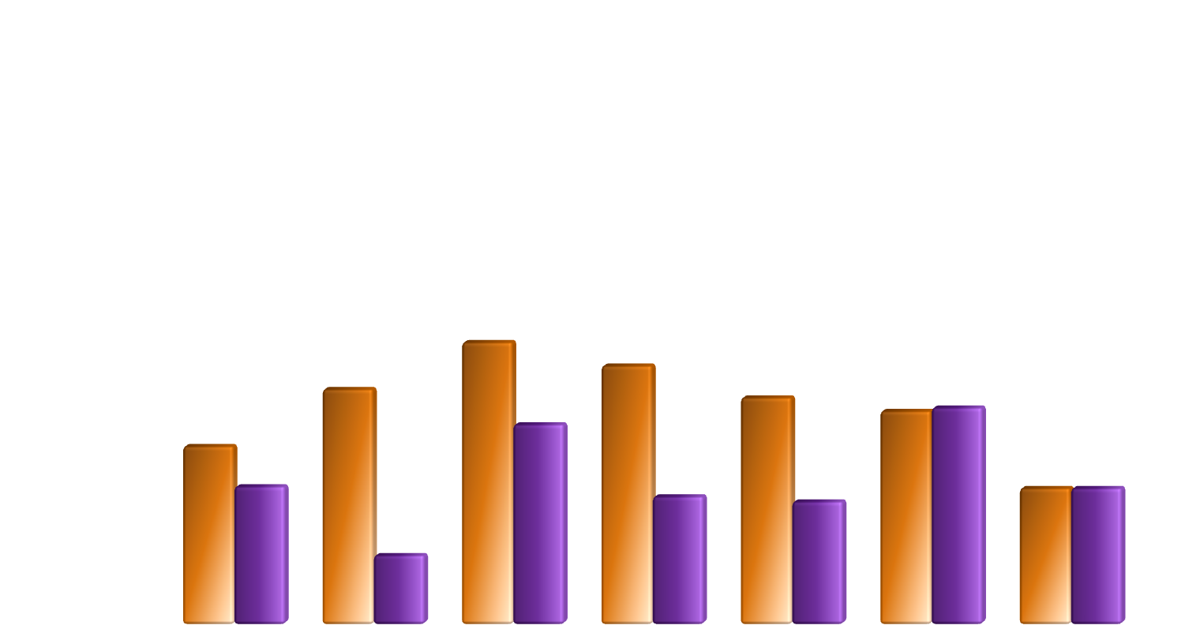

Ⅰ . Primary Problems of Existing Radiation Protection
Radiation Exposure of Major Country during Outage Period(’96~’06)
(Man-mSv)
2,000
1,500
1,000
500
0
Period(’96~’98)
Period(’04~’06)
Period | Germany | Spain | USA | Brazil | French | Japan | Korea
’96~’98 | 1060 | 1400 | 1680 | 1540 | 1350 | 1270 | 810
’04~’06 | 820 | 410 | 1190 | 760 | 730 | 1290 | 810
Notes:
As a result, Korean radiation exposure during Outage period has stayed relatively high in comparison with major country.

Slide 9
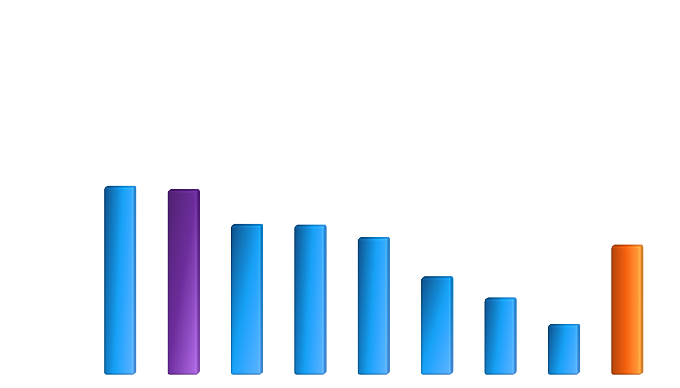
Ⅰ . Primary Problems of Existing Radiation Protection
Radiation Exposure of Korea NPP for Outage Period(The past 3 years)
(Man-mSv)
1000
750
500
250
0
Plant | YUONGKWANG1 | ULJIN1 | KORI2 | KORI1 | YOUNGKWANG2 | ULJIN2 | YUONGKWANG3 | ULJIN3 | Average
Radiation Expousre | 831 | 816 | 662 | 659 | 604 | 430 | 336 | 220 | 570
Notes:
First of all, It`s the biggest problem that Radiation Exposure of old plants such as Uljin NPP 1 in Korea is very high.

Slide 10
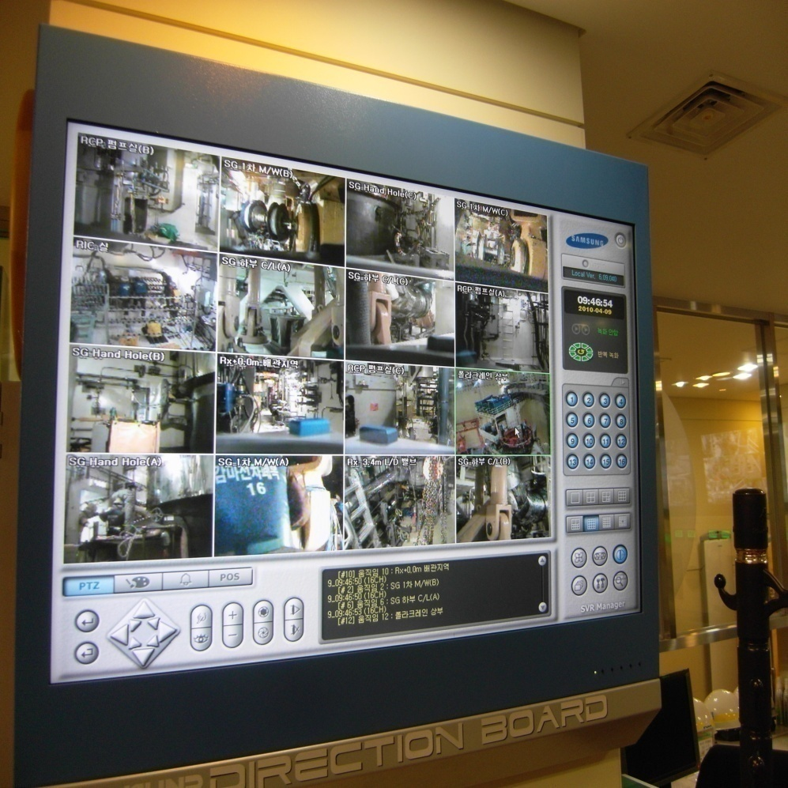
Ⅱ. Features of
Operating RMVS
Notes:
Part 2, Features of Operating RMVS

Slide 11
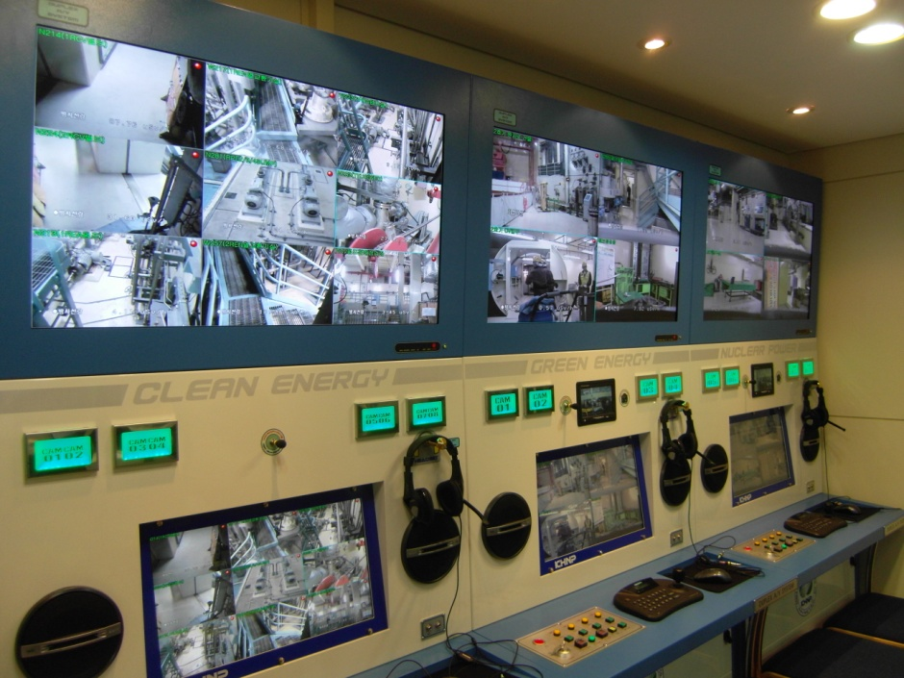
Ⅱ. Features of Operating RMVS
RMVS ?
Remote Monitoring & Video Telephony System
√ Remote Monitoring
√ Remote Control
√ Video Telephony
√ Continuous Radiation Detection
(Telemetry)
Remote Control System
for Radiation Protection
Notes:
RMVS is defined as Remote Monitoring and Video telephony System.
This system has a various functions as follows :
Remote monitoring, remote control, video telephony, and continuous radiation Detection(Telemetry).
These functions allow us to implement remote and real time radiation protection.

Slide 12
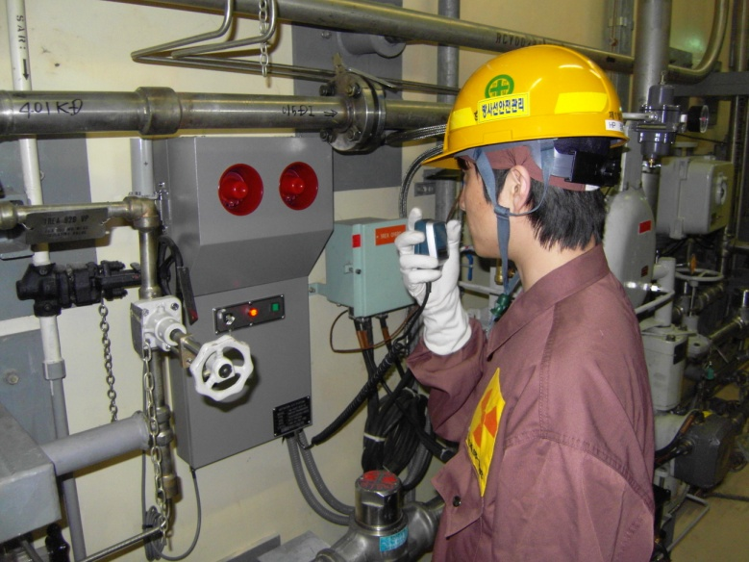
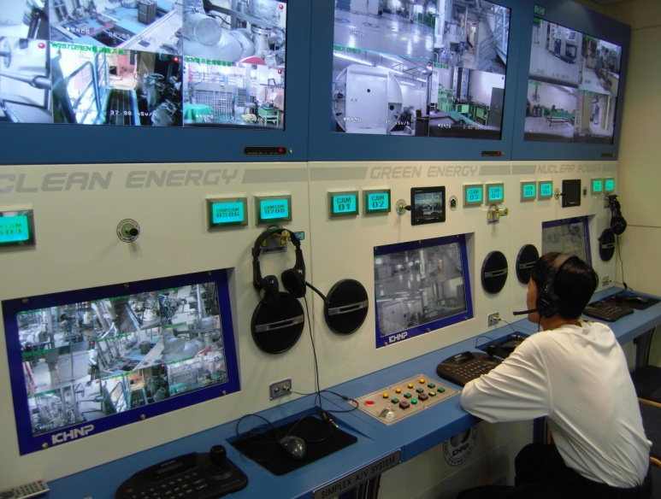
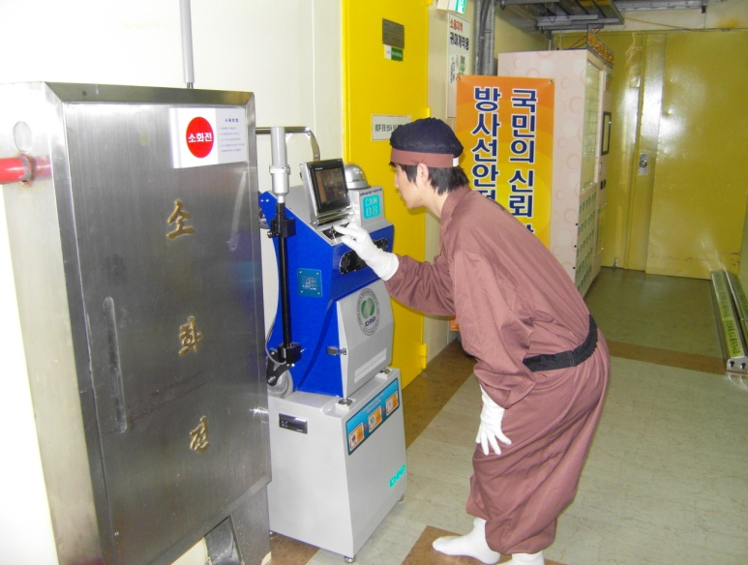
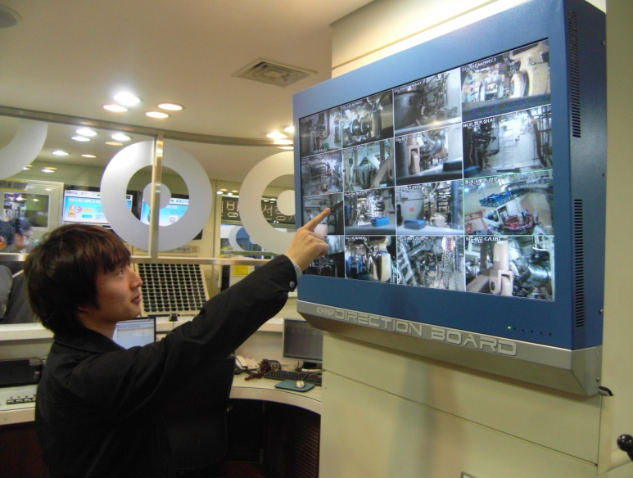
Ⅱ. Features of Operating RMVS
Field
RMVS Control Center
(Health Physics Room)
Notes:
RMVS is compose of Field part and Control Center part that remotely communicate with each other.
I will give a full explanation about RMVS from now on.

Slide 13
Ⅱ. Features of Operating RMVS
1. Operation of RMVS in Reactor Building
√ Operation Period : Outage(2010.02.26 ~ 2010.04.27)
√ Field RMVS Equipments : 16 EA
☞ Location : Primary Radiation Workshop in Reactor Building
√ RMVS Control Center : 2EA
☞ Location : Surroundings of Reactor Cavity / Health Physics Room
Notes:
Firstly, ULJIN NPP 1 have operated RMVS in Reactor Building to resolve primary problems
This RMVS had been operated for the latest outage, and is composed of Field Equipments 16EA and Control Centers 2EA. Field RMVS Equipments are located in primary workshop of Reactor Building, and RMVS control centers are located around reactor cavity & in the Health Physics Room.

Slide 14
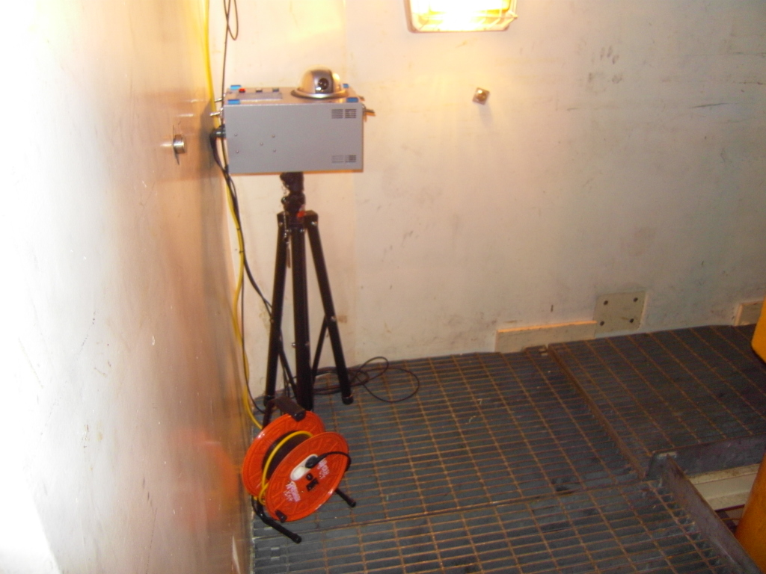
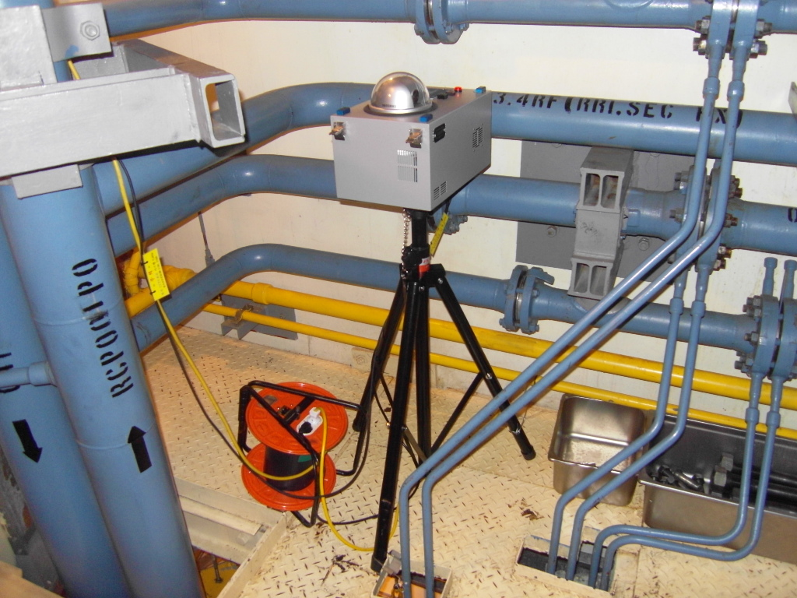
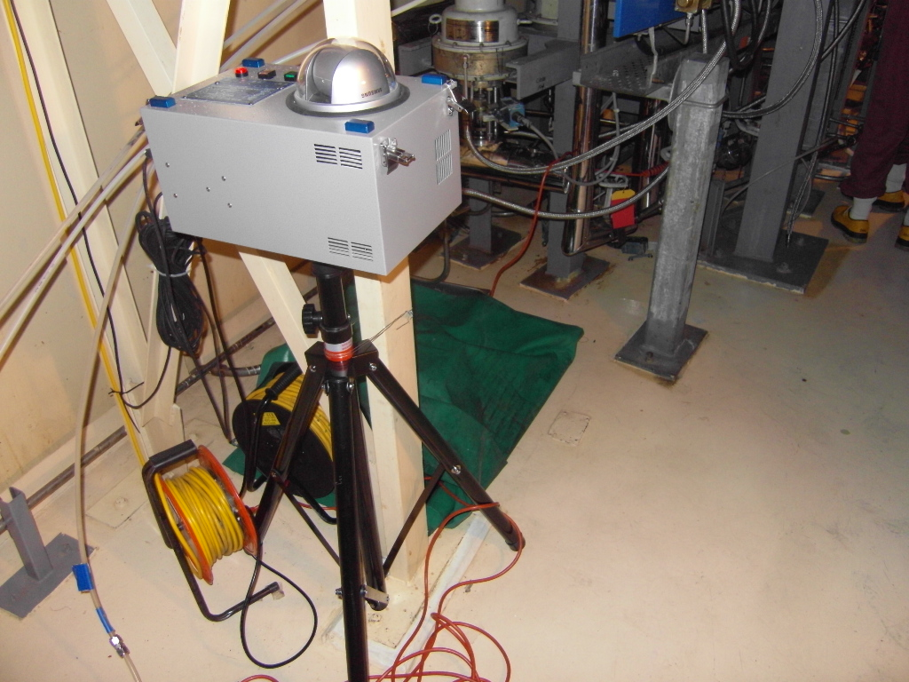
Ⅱ. Features of Operating RMVS
1. Operation of RMVS in Reactor Building
√ Field RMVS Equipments : 16 EA
☞ Location : Primary Radiation Workshop in Reactor Building
√ Equipped with Camera
√ Remote Audio Telecommunication
√ Call Signal Transmission to RP Technicians
√ Mobile Installation
√ Easy Control
√ Page Phone Substitute
Notes:
Field RMVS Equipment is equipped with camera and has features as follows :
Remote audio telecommunication, call signal transmission to RP Technicians, mobile installation, easy control, and page phone substitute.

Slide 15
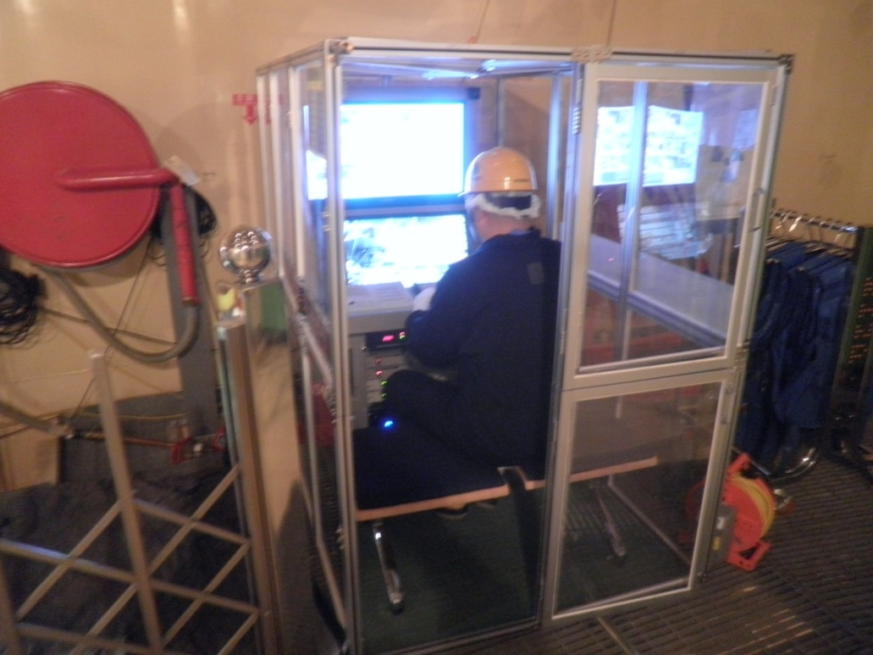
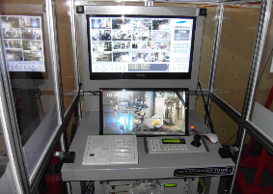

Ⅱ. Features of Operating RMVS
1. Operation of RMVS in Reactor Building
√ RMVS Control Center : 2EA
☞ Location : Side of Reactor Cavity / Health Physics Room
√ 16CH Monitoring
√ Call Signal Transmission to Field Workers/RP Technicians
√ Remote Control for Field RMVS Cameras
√ Real Time Recording
√ Remote Communication with Workers and RP Technician
of Field/Health Physics Room
Notes:
RMVS Control Center has features as follows :
16channel monitoring, call signal transmission to field workers/RP Technicians, remote control for Field RMVS cameras, real time recording, and remote communication with workers/RP Technicians of Field & the Health Physics Room.

Slide 16
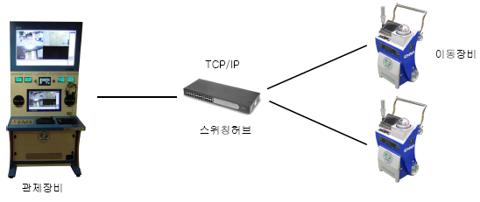
Ⅱ. Features of Operating RMVS
2. Operation of RMVS in High Radiation Area
√ Operation Period : Constant Operation(2010.01 ~ )
√ Field RMVS Equipments : 17 EA
☞ Location : High Radiation Area & Primary Workshop/Passageway
√ RMVS Control Center : 1SET
☞ Location : Health Physics Room
TCP/IP
Field Equipments
Switching Hub
Control Center
Notes:
Secondly, we have operated RMVS in High Radiation Area to resolve primary problems such as Part 1.
This RMVS has been operated from January 2010, and is also composed of Field Equipments 17EA and Control Center 1set. Field RMVS Equipments are located in High Radiation Area & primary workshop/passageway.
RMVS Control Center is located in the Health Physics Room.

Slide 17
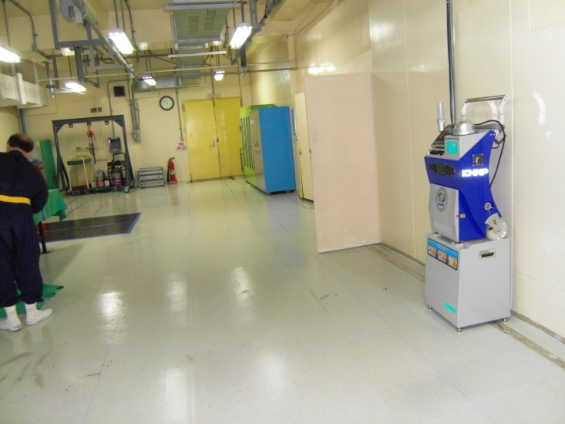
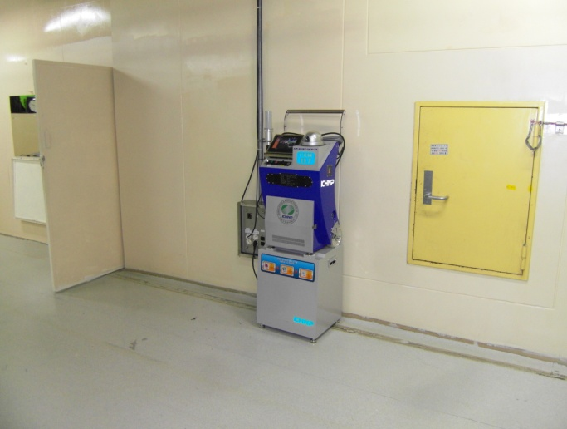

Ⅱ. Features of Operating RMVS
2. Operation of RMVS in High Radiation Area
√ Field RMVS Equipments : 17 EA
☞ Location : High Radiation Area & Primary Workshop/Passageway
√ Equipped with Cameras
√ Video Telephony
√ Continuous Radiation Detection(Telemetry)
√ Call Signal Transmission to RP Technicians by field Workers
√ Mobile Installation
√ Easy Control
√ Page Phone Substitute
Notes:
Field RMVS Equipment of High Radiation Area is equipped with camera and has features as follows :
Video telephony, continuous radiation detection, call signal transmission to RP Technicians by field workers, mobile installation, easy control, and page phone substitute.

Slide 18
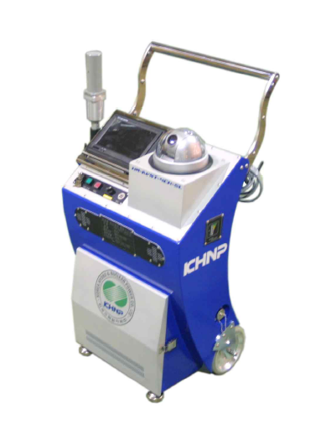
Ⅱ. Features of Operating RMVS
Radiation Detector
Speed Dome Camera
Video Telephony Monitor
Controller
Speaker
Mike
Wheel
Notes:
Field RMVS Equipment is composed of radiation detector, video telephony monitor, controller, speaker mike, wheel, and speed dome camera.

Slide 19

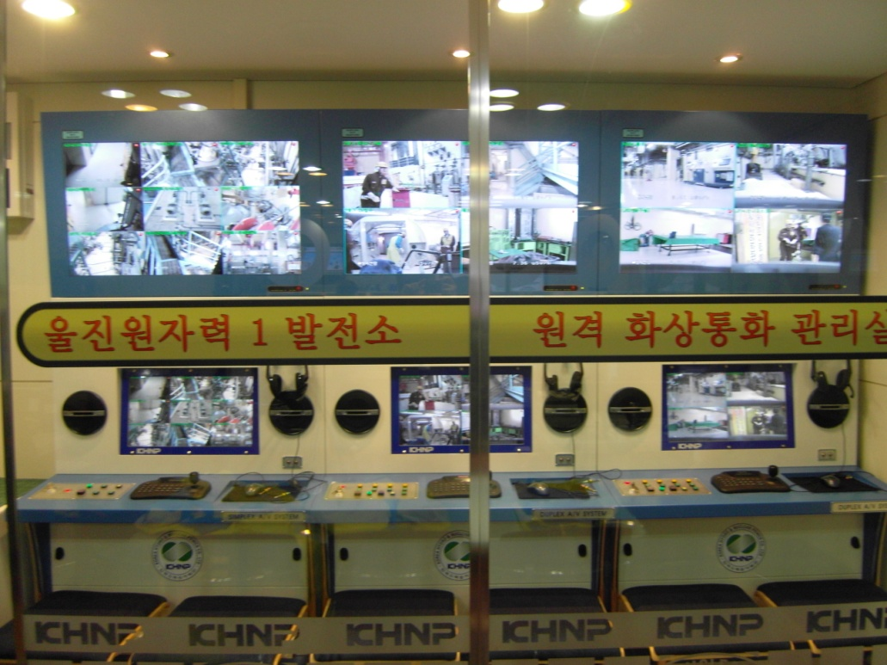
Ⅱ. Features of Operating RMVS
2. Operation of RMVS in High Radiation Area
√ RMVS Control Center : 1SET
☞ Location : Health Physics Room
√ 17CH Monitoring
√ Video Telephony
√ Real Time Display of Radiation Dose Rate from
Field RMVS Equipments
√ Send Call Signal to Field Workers/RP Technicians
√ Remote Control for Field RMVS Camera
√ Real Time Recording
Notes:
RMVS Control Center of High Radiation Area has features as follows :
17channel monitoring, video telephony, real time display of radiation dose rate from Field RMVS Equipments, call signal transmission to field workers/RP Technicians, remote control for Field RMVS cameras, and real time recording.

Slide 20
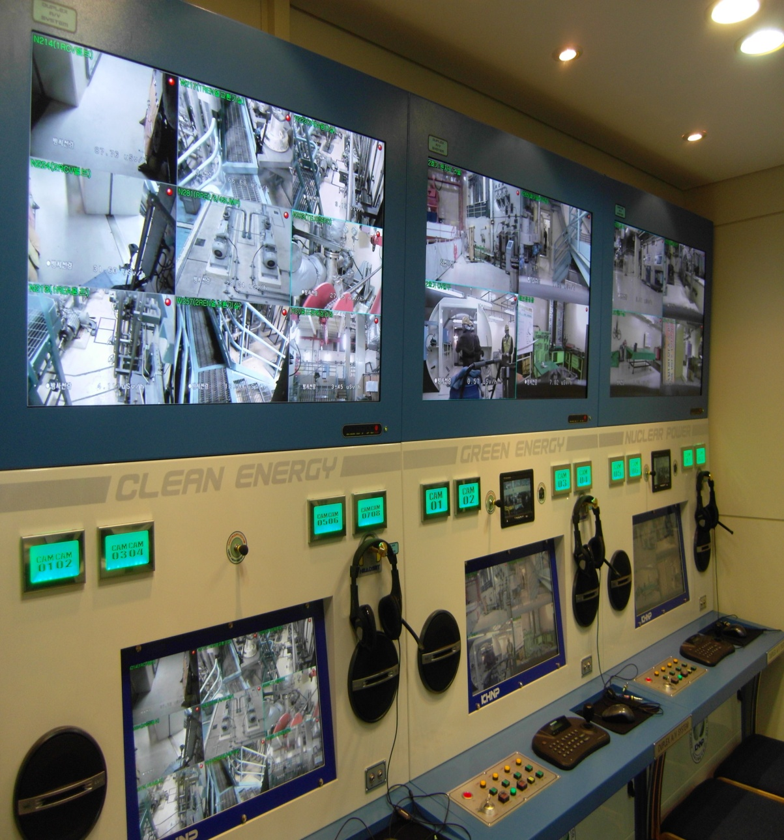
Ⅲ. Features of Operating RMVS
Main Monitor
Auxiliary Monitor
Head Set
Mike
Speaker
Auxiliary Monitor
Control Board
Notes:
RMVS Control Center is composed of Main monitor, auxiliary monitor, head set, mike, speaker, auxiliary monitor, and control board.

Slide 21
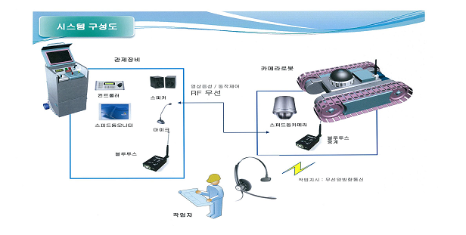
Ⅱ. Features of Operating RMVS
3. Operation of RMVS for Installing/Removing
Nozzle Dam of Steam Generator
√ Operation Period : Installing/Removing Nozzle Dam of
S/G Process during Outage
√ Field RMVS Equipments : 2EA
☞ Location : Inside Hot/Cold Leg of S/G
√ RMVS Control Center : 1EA
☞ Location : Surroundings of S/G Room
Notes:
Thirdly, we also have operated the exclusive RMVS for installing/removing nozzle dam of steam generator.
This RMVS had been operated for latest outage, and is composed of Field Equipments 2set and Control Center 1ea.
Field RMVS Equipments are located inside hot/cold leg of steam generator, and RMVS Control Center is located around the steam generator room.

Slide 22
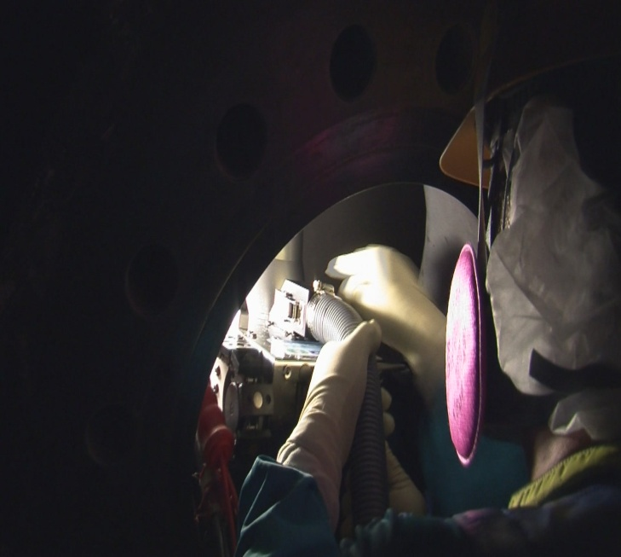
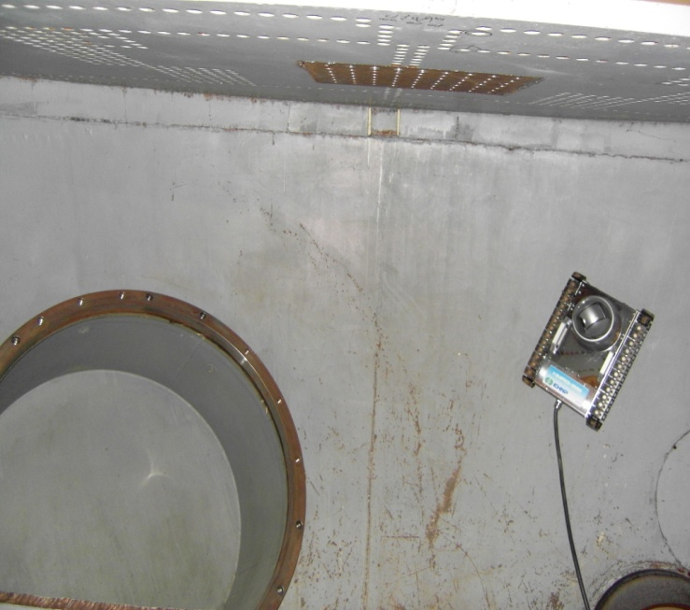
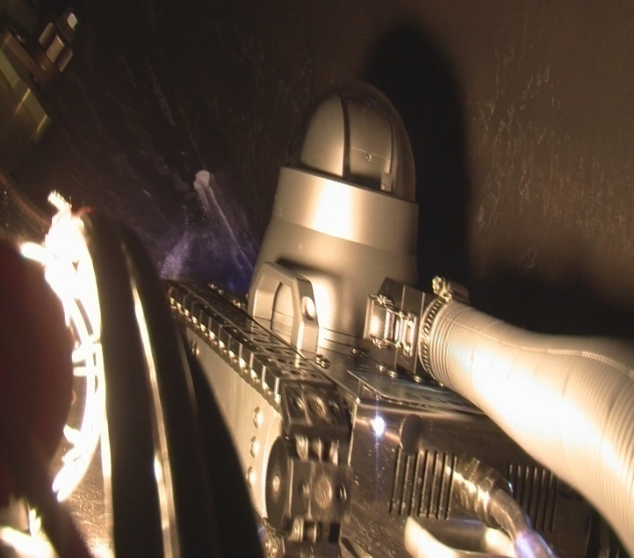
Ⅱ. Features of Operating RMVS
3. Operation of RMVS for Installing/Removing
Nozzle Dam of Steam Generator
√ Field RMVS Equipments : 2EA
☞ Location : Inside Hot/Cold Leg of S/G
√ Equipped with Camera
√ Remote Audio Telecommunication(Blue Tooth Head Set)
√ Moved & Fixed on the Surface of Steep Wall
by Caterpillar & Magnetic Wheel
√ Easy Control
Notes:
Field RMVS Equipment for installing/removing nozzle dam of steam generator is equipped with camera, and has features as follows :
Remote audio telecommunication(blue tooth head set), installation of caterpillar-magnetic wheel to be moved & fixed on the surface of steep wall, and easy control.

Slide 23
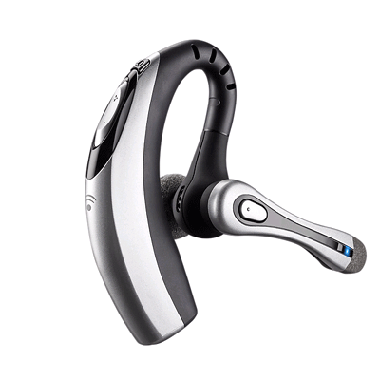
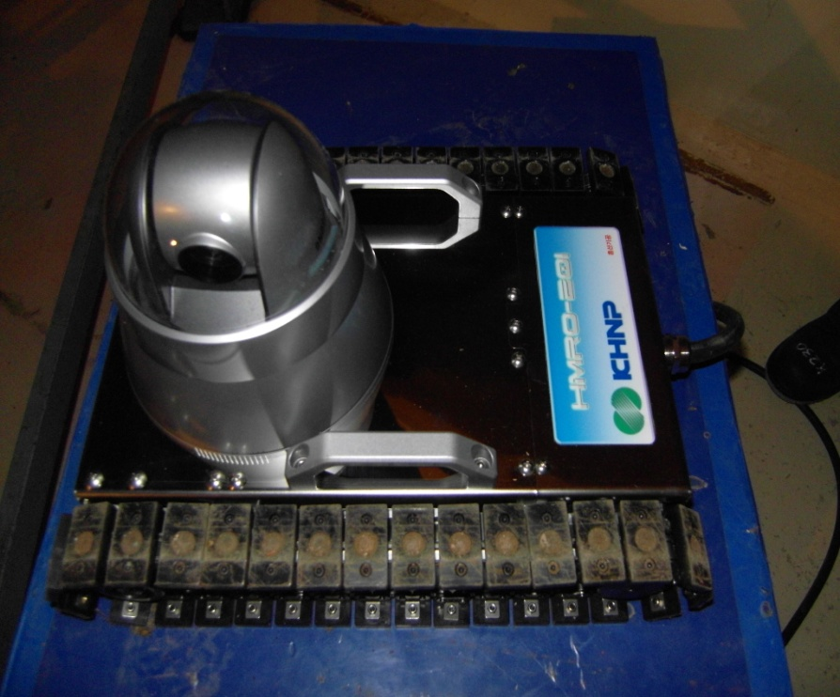
Ⅱ. Features of Operating RMVS
Speed Dome Camera
Blue Tooth
Head Set
Caterpillar & Magnetic Wheel
Notes:
The Field RMVS Equipment is composed of the body, speed dome camera, caterpillar-Magnetic wheel, and blue tooth head set.

Slide 24
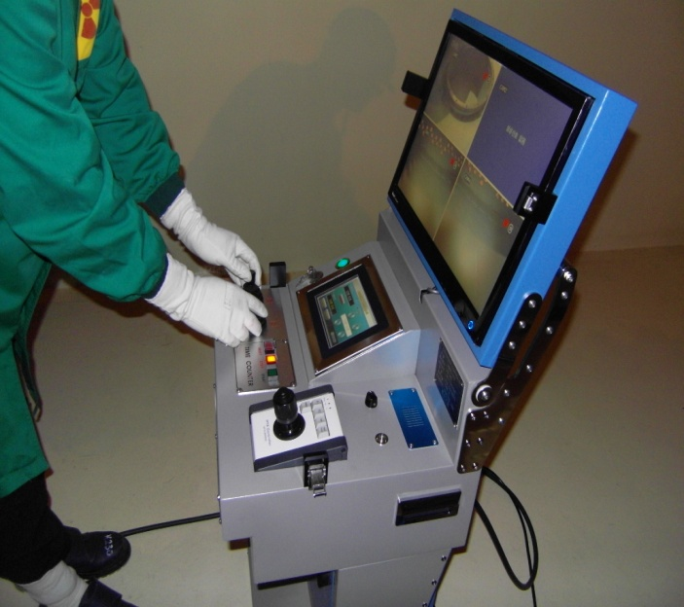
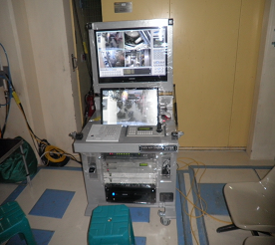
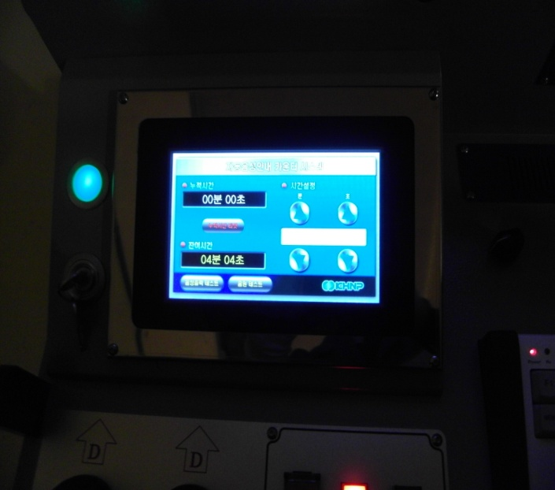
Ⅱ. Features of Operating RMVS
3. Operation of RMVS for Installing/Removing
Nozzle Dam of Steam Generator
√ RMVS Control Center : 1EA
☞ Location : Outside of S/G Room
√ 2CH Monitoring(Maximum 4CH)
√ Remote Telecommunication(Blue Tooth)
√ Counting Work Time
√ Remote Control for Field RMVS Equipments
√ Real Time Recording
Notes:
RMVS Control Center for installing/removing nozzle dam of steam generator has features as follows :
2channel monitoring(maximum 4channel), remote telecommunication(blue tooth), counting work time, remote control for Field RMVS Equipments, and real time recording.

Slide 25
Ⅱ. Features of Operating RMVS
Large Monitor
Display Monitor of Counting Work Time
Control Button
Control Handle
Notes:
RMVS Control Center is composed of large monitor, display monitor of counting work time, control buttons, and control handle.

Slide 26
Ⅱ. Features of Operating RMVS
Production Cost of RMVS
√ Reactor Building RMVS
85,800,000 won
Control Center 1Set
Field Equipments 16EA
√ High Radiation Area RMVS
180,000,000 won
Control Center 1Set
Field Equipments 17EA
√ Steam Generator RMVS
140,000,000 won
Control Center 1Set
Field Equipments 2EA
Total Production Cost : 495,800,000 won
Notes:
Total production cost of RMVS is 495,800,000 won. Detailed cost is as follows :
Reactor building RMVS is 85,800,000 won, High Radiation Area RMVS is 180,000,000 won, and
Steam Generator RMVS is 140,000,000 won.

Slide 27
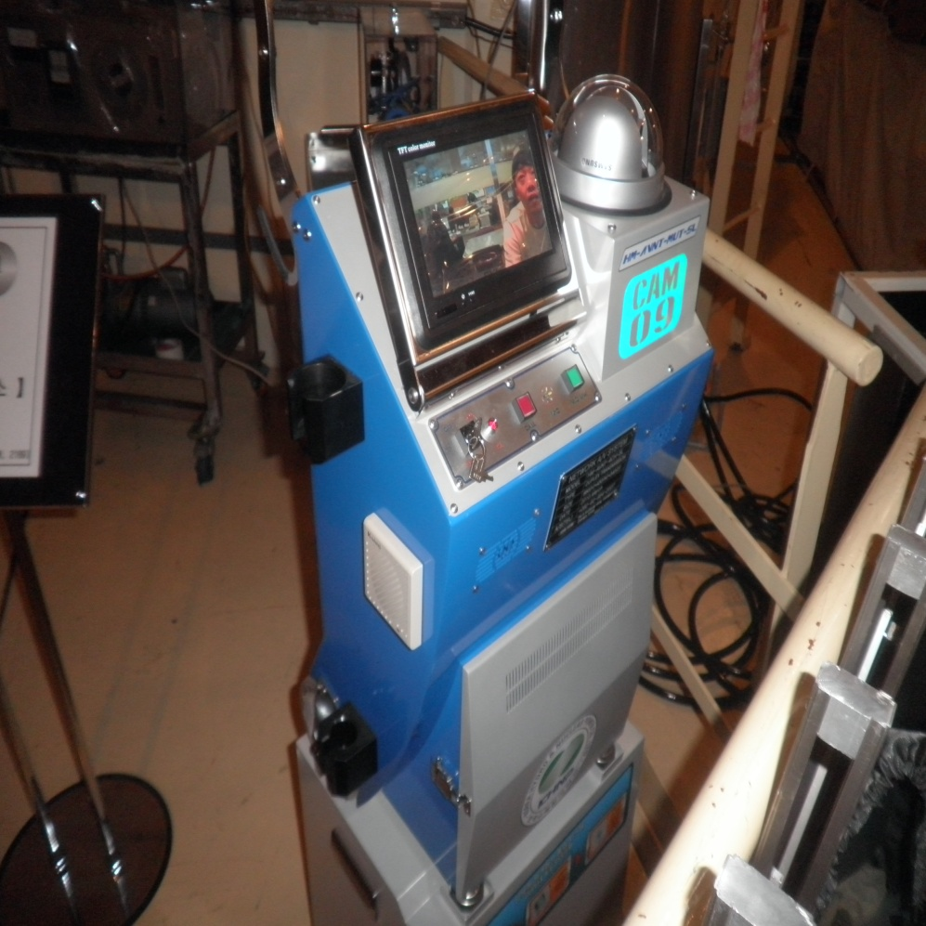
Ⅲ. Benefits of
Operating RMVS
Notes:
Part 3, Benefits of Operating RMVS.

Slide 28
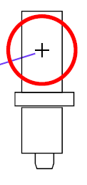
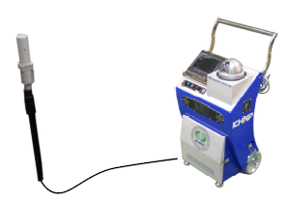
Ⅲ. Benefits of Operating RMVS
1. Reduction of Radiation Exposure &
Advancement of Radiation Protection
√ Real Time Monitoring of Radiation Dose Rate
from Primary Workshop
☞ Equipped with Radiation Detector
√ GM Type
√ 0.01μSv ~ 10,000,000 μSv
Notes:
In this part, I would like to explain benefits of operating RMVS.
Firstly, we have reduced radiation exposure and advanced radiation protection implements because of the reasons as follows :
RMVS can monitor in real time radiation dose rate, which is equipped with radiation detector as you see this presentation.

Slide 29

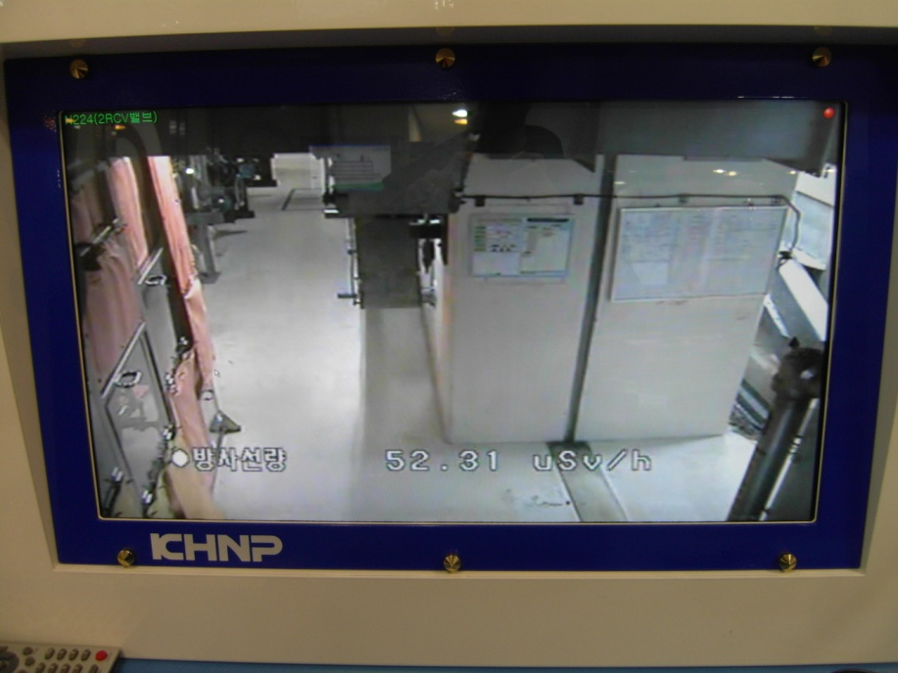
Ⅲ. Benefits of Operating RMVS
1. Reduction of Radiation Exposure &
Advancement of Radiation Protection
√ Real Time Monitoring of Radiation Dose Rate
from Primary Workshop
☞ Real Time Display of Dose Rate from Field RMVS Equipments
Notes:
In addition, Dose rate can be displayed on RMVS Control Center monitor in real time from Field Equipments.

Slide 30
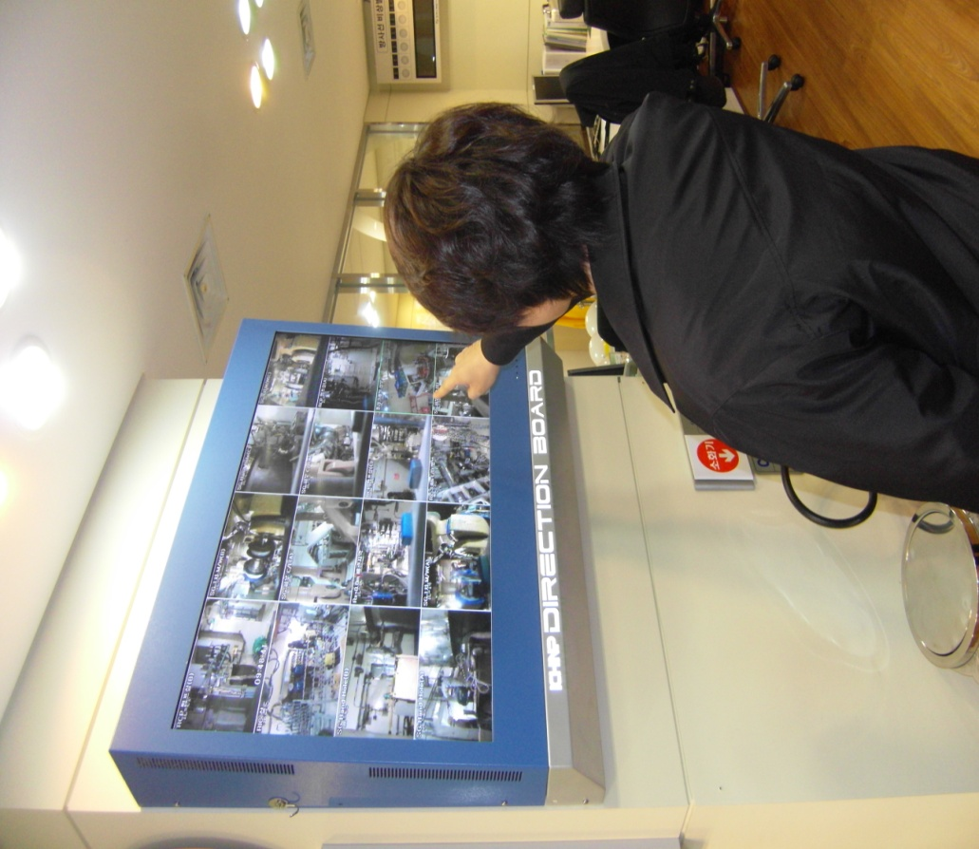
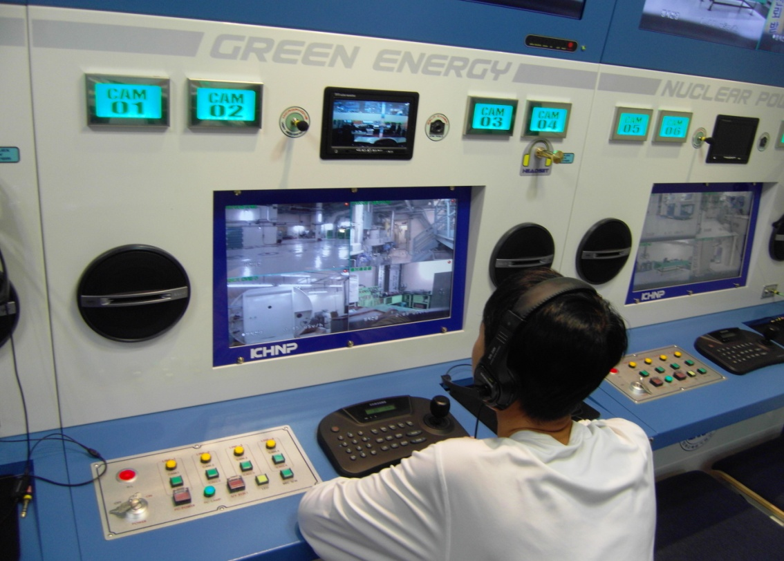
Ⅲ. Benefits of Operating RMVS
1. Reduction of Radiation Exposure &
Advancement of Radiation Protection
√ Real Time Control for Field Violators of Radiation
Protection Regulations
☞ Monitoring/Controlling Access of Unauthorized Worker to Restricted
Area
☞ Remote Assistance of Field Worker in adherence to Plant Procedures
☞ Multi & Continuous Radiation Protection by Field RP Technicians
& RMVS Control Center Master in Health Physics Room
Notes:
And RMVS can monitor & control access of unauthorized workers to restricted area, and assist remotely field workers in adherence to plant procedures, and implement multi & continuous radiation protection.

Slide 31
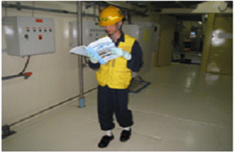
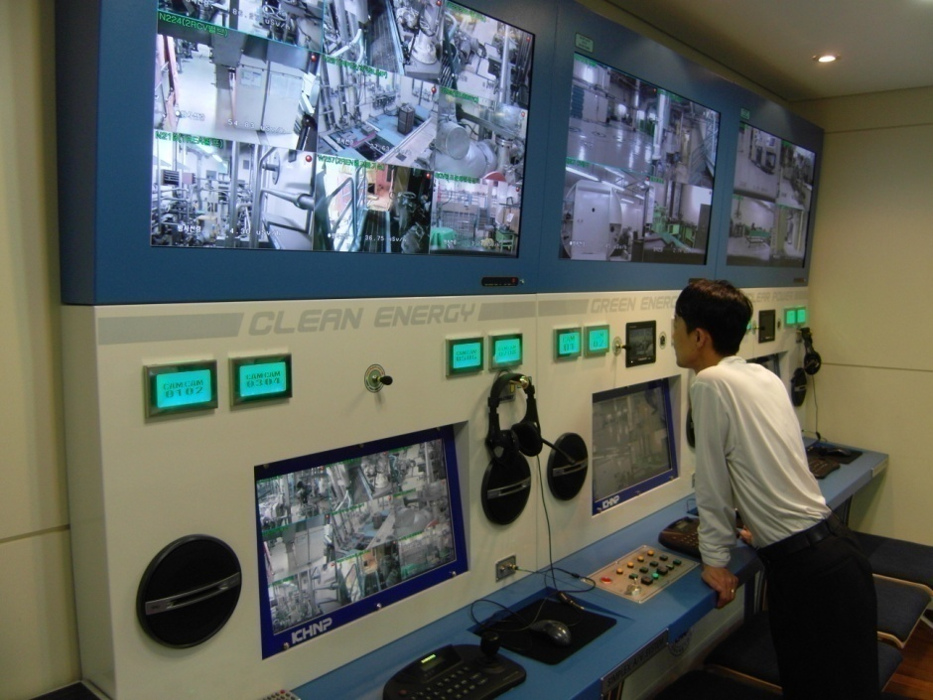
Ⅲ. Benefits of Operating RMVS
1. Reduction of Radiation Exposure &
Advancement of Radiation Protection
√ Reduction of Working Time &
the Number of People Accessing Workshop
☞ Direct Intervention by Supervisor to Support Repairs & Complex
Tasks without Requiring Supervisor to Enter Workshop
Notes:
In addition, RMVS can reduce work time & the number of people accessing workshop by means of direct intervention by supervisor to support repairs & complex tasks without requiring supervisor to enter workshop.

Slide 32




Ⅲ. Benefits of Operating RMVS
1. Reduction of Radiation Exposure &
Advancement of Radiation Protection
√ Reduction of Radiation Exposure by Operating RMVS
Radiation Exposure during Outage
(man-mSv)
1,000
800
600
400
200
0
Reduced Radiation Exposure
in comparison with Pre-Operation
226 man-mSv
Classification
Fifteenth(2008)
Sixteenth(2010)
Radiation Exposure
798
571
Notes:
As a result of operating RMVS, radiation exposure during the latest outage was reduced from 798 to 571 man-mSv such as you see in this graph.

Slide 33



Ⅲ. Benefits of Operating RMVS
1. Reduction of Radiation Exposure &
Advancement of Radiation Protection
(Man-mSv)
Before Operation(Fifteenth Outage)
After Operation(Sixteenth Outage)
180
140
120
100
80
60
40
20
0
내용 | Reactor Assembly Disassembly | Steam Generator Works | System Operation | In-core Thimble | ISI | Valve Disassembly Check | Primary Pump Check | Vibration Isolation Check | Boron Corrosion Test | LLRT | Gauge Calibration | RCP Check | Radiation Safety Management | Decontamination, Laundry & Radwaste Process | The Other Works | Total
Before | 72.83 | 180.7 | 30.21 | 35.29 | 80.83 | 88.23 | 4.21 | 33.50 | 14.30 | 9.78 | 49.89 | 8.03 | 66.45 | 57.36 | 61.82 | 797.79
After | 58.86 | 112.47 | 25.98 | 36.34 | 63.81 | 73.65 | 4.32 | 15.62 | 6.89 | 7.90 | 28.81 | 8.97 | 13.76 | 19.41 | 94.97 | 571.76
Radiation Exposure | -66.95 | -68.23 | -4.23 | 1.55 | -17.02 | -14.58 | 0.11 | -17.88 | -7.41 | -1.88 | -21.08 | 0.94 | -52.69 | -37.95 | 33.15 | -226.03
571.76
The Lowest Level since the First Operation!!
Notes:
Detailed reduction results of radiation exposure are tabulated as follows. 571.76 man-mSv is the lowest level since the first operation of ULJIN NPP Unit 2.

Slide 34

Ⅲ. Benefits of Operating RMVS
1. Reduction of Radiation Exposure &
Advancement of Radiation Protection
Before(Fifteenth Outage)
After(Sixteenth Outage)
Before(Fifteenth Outage)
After(Sixteenth Outage)
30,000
25,000
20,000
15,000
10,000
5,000
0
36
30
24
18
12
6
0
0.035
0.030
0.025
0.020
0.015
0.010
0.005
0
The number of Entrance(Persons)
Personal Average Radiation Exposure
Outage Periods(Days)
Outage | Persons | Days
15th | 22,621 | 31
16th | 23,842 | 33
Outage | Personal Average Radiation Exposure(mSv)
15th | 0.035
16th | 0.023
Notes:
Although the number of entrance to radiation area during 16th Outage was increased slightly in comparison with 15th Outage, personal average radiation exposure was decreased sharply from 0.035 to 0.028 mSv with the help of RMVS.

Slide 35
Ⅲ. Benefits of Operating RMVS
1. Reduction of Radiation Exposure &
Advancement of Radiation Protection
√ Reduction of Radiation Exposure by Operating RMVS
Radiation Exposure in High Radiation Area
(man-mSv)
100
80
60
40
20
0
Reduced Radiation Exposure
in comparison with Pre-Operation
58.16 man-mSv
구 분
’08.01.01 ~ 03.25
’09.01.01 ~ 03.25
Radiation Exposure
22.08
7.54
Yearly Calculation
88.32
30.16
Notes:
As the result of operating RMVS, Radiation exposure in High Radiation Area was also reduced from 88.32 to 30.16 man-mSv as you see in this graph.

Slide 36
Ⅲ. Benefits of Operating RMVS
1. Reduction of Radiation Exposure &
Advancement of Radiation Protection
Before(2008.01.01~03.25)
After(2010.01.01~03.25)
(Man-mSv)
12
10
8
6
4
2
0
Classification | System Operation | Radiation Safety Management | Radwaste Process | Decontamination & The Other Works | Total | Yearly Calculation
Before | 5.03 | 4.55 | 10.71 | 1.79 | 22.08 | 88.32
After | 1.87 | 0.57 | 4.50 | 0.60 | 7.54 | 30.16
Dose Difference | -3.16 | -3.98 | -6.21 | -1.19 | -14.54 | -58.16
-58.16
Notes:
Detailed reduction results of radiation exposure in High Radiation Area are tabulated as follows.
Total radiation exposure was reduced by 58.16 man-mSv.

Slide 37
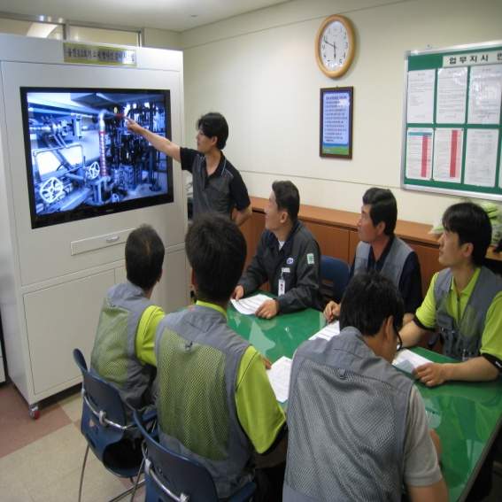
Ⅲ. Benefits of Operating RMVS
2. Prompt Response for Emergency Situation
√ Early Detection of Abnormal Radiation,
Equipments & Facilities
√ Expansion of RMVS to KHNP Intranet
3. Improvement of Work Efficiency
√ Reference Materials for Pre-job Briefing & Job Training
√ Prompt & Remote Instruction of Supervisor by using
RMVS
Notes:
Secondly, we can respond promptly for emergency situation by means of early detection of abnormal radiation/equipments/facilities and expansion of RMVS to KHNP Intranet.
Finally, work efficiency has been improved by using RMVS for reference materials for pre-job Briefing & job training and prompt/remote work instruction.

Slide 38
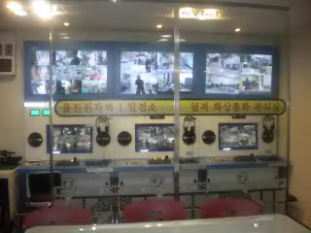
Ⅲ. Benefits of Operating RMVS
Information Video for RMVS Operation
Notes:
Until now, I have gave a full explanation about RMVS.
I will show information video for RMVS Operation for about 2 minutes.

Slide 39
Thank You
Notes:
Thank you for your attention.
I will now take any questions you may have.

